Slide 1


Subject: Maths
Pack: A

Slide 2


Date: 01.03.21
L.O: To be able to round decimal numbers.
Subject: Maths

Slide 3
Mental Starter:
Identify the value of the digit underlined
(Recap from last week’s learning)
E.G 134.25= 5 hundredths
1. 292.17 =
2. 565.123 =
3. 1820.021 =
4. 7225.622 =
5. 892.345 =
Extension: Order the numbers used in each question from smallest to largest
292.17 565.123 1820.021 7225.622 892.345
Smallest Largest
_______ ________ ________ ________ ________

Slide 4
Mental Starter:
Let’s check your answers:
E.G 134.25= 5 hundredths
1. 292.17 = 1 tenth
2. 565.123 = 3 thousandths
3. 1820.021 = 0 tenths
4. 7225.622 = 2 thousandths
5. 892.345 = 4 hundredths
Extension: Order the numbers used in each question from smallest to largest
292.17 565.123 1820.021 7225.622 892.345
Smallest: Largest
292.17 565.123 892.345 1820.021 7225.622

Slide 5
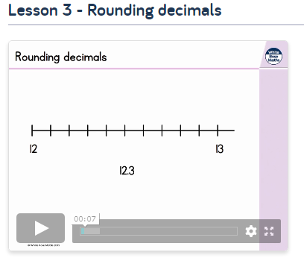


Pre-recorded Teaching
Access the online teaching video below that will support you to complete the work in this lesson. This video will act as a support but all of the work can still be successfully understood & completed using paper-based versions of this pack. If you need further support to understand / complete work then please contact school via e-mail or telephone.
The link below will take you to White Rose Home learning, you will need to scroll down the page until you can see the different weeks and then select Summer Term – Week 6. Scroll down to ‘Lesson 3 Rounding Decimals and watch the video.
Play video
You can also copy and paste this link if you would prefer (but the instructions need to be followed to access the video):
https://whiterosemaths.com/homelearning/summer-archive/year-5/

Slide 6



Rounding Decimals
Rounding is important because it makes numbers easier to manage and allows us to estimate answers.
Imagine you’re in a shop and you need to quickly estimate how much your shopping will be before you get to the till. You would round up the prices, like £1.99 to £2.00, to make it easier to add up.
The rule for rounding
Always look at the digit to the right of the one you’re supposed to be rounding to:
if it is 5 or more, then round it up
if it is less than 5, then round down
If the digit ends with 5,6,7,8 or 9 we round up!
If the digit ends with 1,2,3 or 4 we round down!

Slide 7
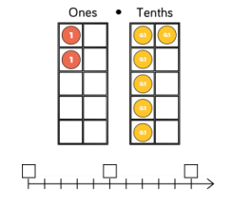
Rounding to the nearest whole number
Look at the tenths digit (the digit after the decimal point). if it is less than 5 then round the number down by removing the decimal part of the number; if it is 5 or more then round the number up by adding one on to the ones digit and removing the decimal part of the number.
E.G The number shown is 1.6.
If we use a number line, we can see 1.6 is closer to 2.
As we are rounding to the nearest whole number, we
look at the tenths.
We know 6 is more than 5, following the rules for rounding,
this is why we would round 1.6 up to 2.
1
1.5
2

Slide 8
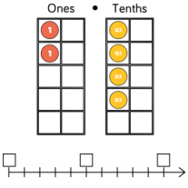

Let’s try rounding to a whole number together:
What number has been created?
2.4
Look at the tenths, how many are there?
4 tenths
If we use the number line, is 2.4 less than 2.5?
Is 2.4 closer to 2 or 3?
Do we round up to 3 or down to 2?
2
2.5
3

Slide 9

We would round down to 2.
We can see 2.4 is closer to 2.
Because 4 is less than 5, we follow the rule and round down.
2.4

Slide 10
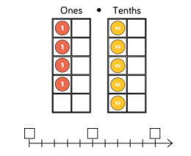

Round to the nearest whole number:

Slide 11
Let’s check:
Round to the nearest whole number:
The number shown is 4.5.
It has 5 tenths.
We know if the digit we’re looking at is 5 or above, we round up.
On a number line we can see 4.5 is in the middle of 4 and 5.
We round 4.5 up to 5.
4
4.5
5

Slide 12
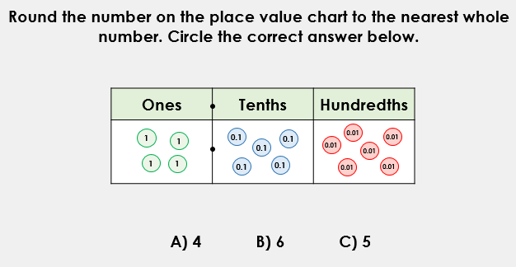
Try this:
As we are rounding the nearest whole number, you still need to focus on the tenths and decide if you will round the whole number up to the next or down to the whole number we already have.

Slide 13
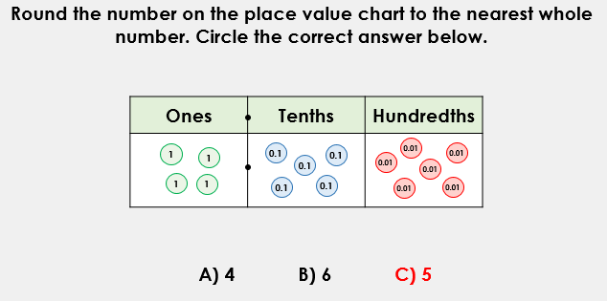
Let’s check:
The number created is 4.56
We need to look at the tenths, we can ignore the hundredths.
There are 5 tenths.
We know this means to round up.
The next whole number after 4 is 5.
4.56 rounds up to the next whole number 5.

Slide 14
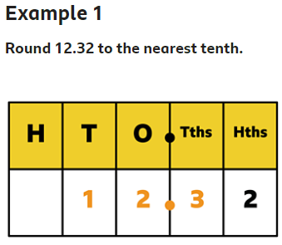
Rounding to the nearest tenth/ 1dp
We apply the same rounding rules again.
When rounding to the nearest tenth (1dp), we need to look at the hundredths.
If the hundredths is 1-4, we round the tenth down (to the tenth we have).
If the hundredth is 5-9, we round the tenth up (to the next tenth).
The whole number will rarely change and often stays the same, unless the rounding of the tenth makes it greater than 9.
The digit in the hundredths column is a 2, so we round down to 12.3

Slide 15
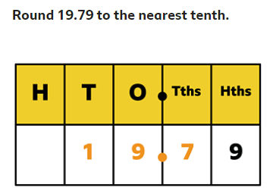
Rounding to the nearest tenth/ 1dp
How many hundredths does the number have?
Will we round the tenths digit up or down?
Will the tenths digit change or stay the same?

Slide 16
Lets check:
9 is in the hundredths, so we round up to 19.8.
There are 9 hundredths.
9 is greater than 5, therefore we round up.
This means then we change to the next tenth, after 7 is 8 therefore the tenths changes to 8.

Slide 17
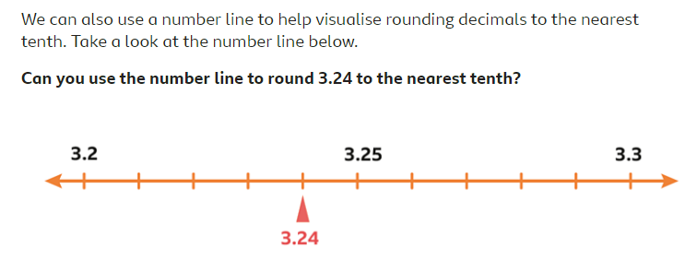
Round the number below to 1dp.
(Nearest tenth)
There are 4 hundredths, apply the rules to decide if we round 3.24 down to 3.2 or up to 3.3.

Slide 18
Rounding to 2dp (hundredths)
When rounding to 2dp, we need to look at the thousandths.
Identify if it is smaller or bigger than 5.
If it is smaller, we round the hundredth down to the digit we have.
If it is larger, we round the hundredth up to the next digit.
E.G: 123.678
8 thousandths…
8 is larger than 5…
Round the hundredths up…
7 rounds up to the next digit which is 8
123.68

Slide 19
Rounding to 2 dp
1612.821
How many thousandths are there?___
Is it more or less than 5? ______
Does the hundredth round up or down? _____
Will the hundredth change?_____
What digit does the hundredth become?_____
Answer: ________

Slide 20
Let’s check:
1612.821
How many thousandths are there?_1_
Is it more or less than 5? __less__
Does the hundredth round up or down? __down_
Will the hundredth change?__no__
What digit does the hundredth become?__2__
Answer: 1612.82

Slide 21
Rounding to 2dp
Now try this:
302.018
Rounds up or down?______
Answer:______

Slide 22
Rounding to 2dp
Let’s check:
302.018
Rounds up or down? 8 thousandths round hundredths up
Answer: 302.02

Slide 23
L.O: To be able to round decimal numbers
Copy the numbers for each question down as shown:
Eg. 543.561 543.56
Round to the nearest whole number:
234.6
192.31
310.28
Round each number to 1 dp
4. 238.023
5. 922.996
6. 223.172
Round each number to 2 dp.
7. 2391.017
8. 3402.459
9. 5617.244
10. 806.109

Slide 24
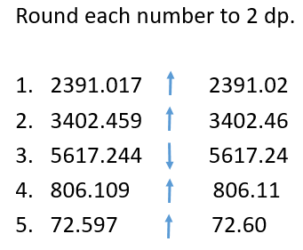
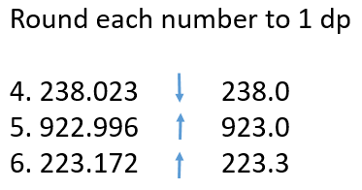
Answers:
Round to nearest whole number.
234.6 230
192.31 192
310.28 310

Slide 25

Times-table practise
Spend at least 15mins practising your times-tables.
This can be done on TTRS, hit the button or any other times-table website.
Use the Times-Tables Rock Stars app or website.
Alternatively, copy and paste the following link into a web browser:
https://play.ttrockstars.com/auth/school/student/73173
https://www.topmarks.co.uk/maths-games/7-11-years/times-tables

Slide 26
End of Lesson

Slide 27
Date: 02.03.21
L.O: To be able to round decimal numbers.
Subject: Maths

Slide 28
Mental Starter: Rounding whole numbers
Apply the rules of rounding to round these whole numbers:
Nearest 10 Nearest 100 Nearest 1000
E.G 1723 1720 1700 2000
4234
5619
8563
The rule for rounding
Always look at the digit to the right of the one you’re supposed to be rounding to: if it is 5 or more, then round it up
if it is less than 5, then round down

Slide 29
Mental Starter: Rounding whole numbers
Let’s chek:
Nearest 10 Nearest 100 Nearest 1000
E.G 1723 1720 1700 2000
4234 4230 4200 4000
5619 5620 5600 6000
8563 8560 8600 9000

Slide 30
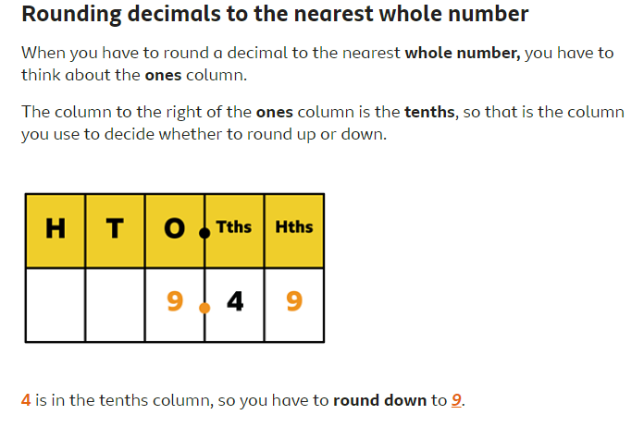
Rounding decimals recap:
The rule for rounding
Always look at the digit to the right of the one you’re supposed to be rounding to:
if it is 5 or more, then round it up
if it is less than 5, then round down

Slide 31
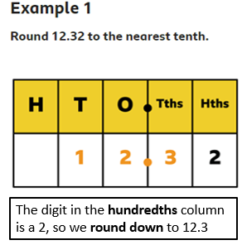
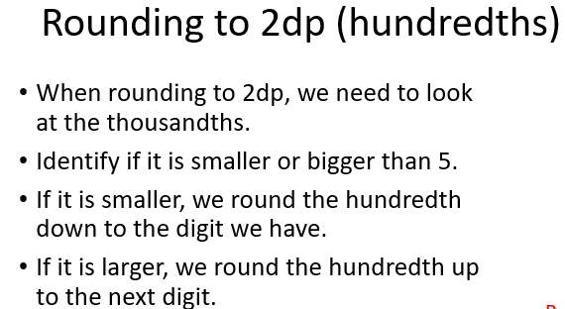
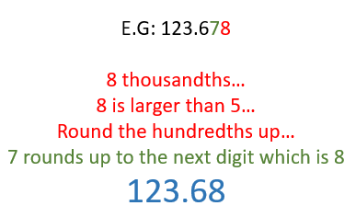
Rounding to nearest tenth/ 1 dp

Slide 32
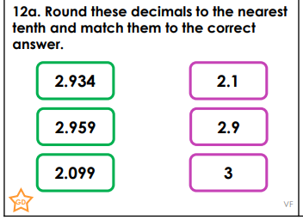
Rounding decimals problem solving:
Apply the rules of rounding to support with the answers.
Which green card numbers matches with the pink card numbers?

Slide 33
Let’s check your answers:

Slide 34
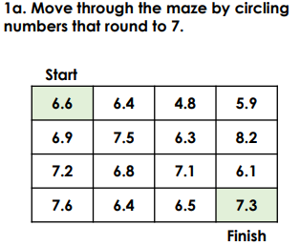
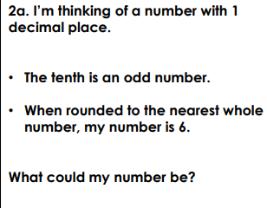
L.O: To be able to round decimal numbers

Slide 35
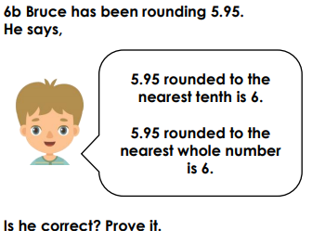
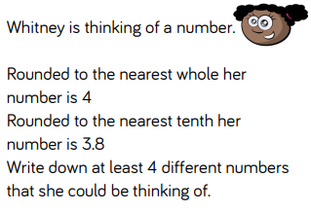
3
4

Slide 36
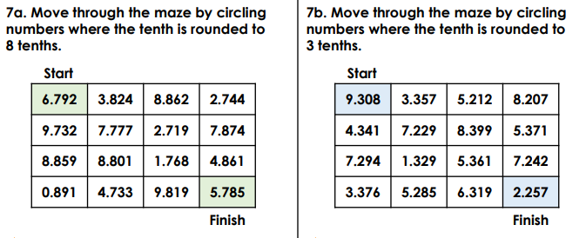
5
6

Slide 37

Answers:
. Possible answers: 5.5, 5.7, 5.9, 6.1 or 6.3

Slide 38

3
4
Bruce is correct. The 5 hundredths means that the 9 tenths is rounded to the next whole number.

Slide 39


5
6

Slide 40
Times-table practise
Spend at least 15mins practising your times-tables.
This can be done on TTRS, hit the button or any other times-table website.
Use the Times-Tables Rock Stars app or website.
Alternatively, copy and paste the following link into a web browser:
https://play.ttrockstars.com/auth/school/student/73173
https://www.topmarks.co.uk/maths-games/7-11-years/times-tables

Slide 41
End of Lesson

Slide 42
Date: 03.03.21
L.O: To be able to multiply decimal numbers.
Subject: Maths

Slide 43
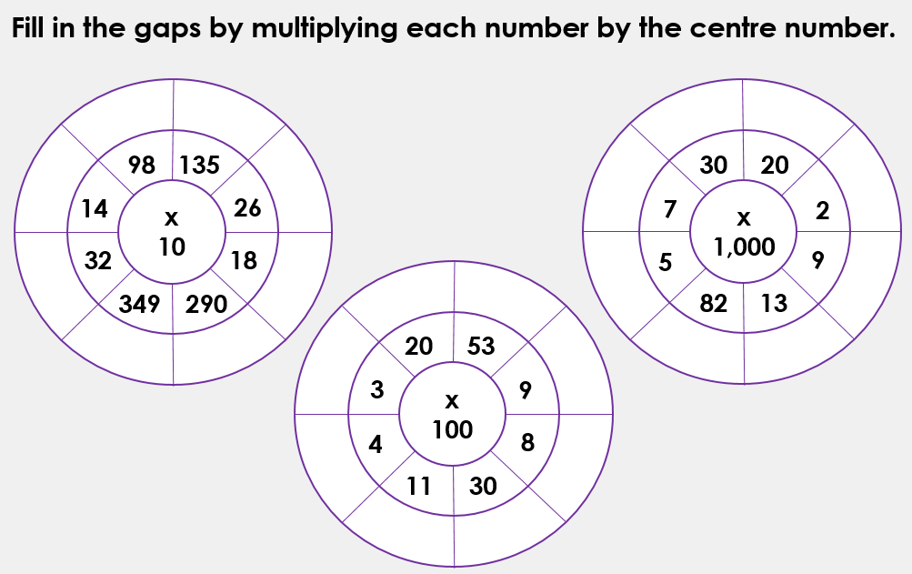
Mental Starter: x10, x100 and x 1000
If you do not have this page, you can write down the answers on a piece of paper.

Slide 44
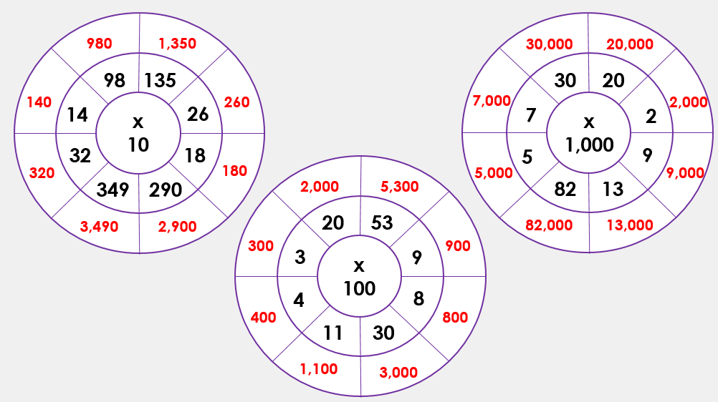
Let’s check your answers:

Slide 45
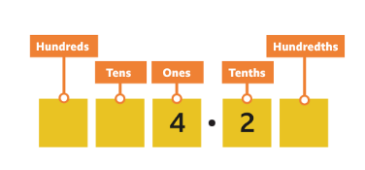
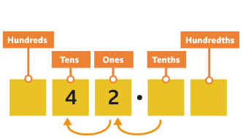
Multiplying decimals by 10
To multiply by 10, you move the digits one place value to the left.
Let's look at an example:
4.2 x 10 = 42
To multiply by 10, you move the digits one place value to the left.
So 4.2 x 10 = 42.
We don’t have any numbers after the decimal point now so we don’t have to include it!

Slide 46
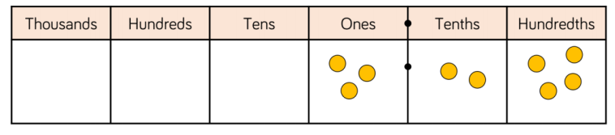



Multiplying decimals by 10
The number represented is 3.24.
When we x10, each digit moves one place to the left.
The answer is 32.4

Slide 47

Multiplying decimals by 10
What number is shown?_____
Draw the counters in the place value chart after moving them one place to the left.
Write down the answer: ______

Slide 48

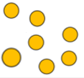

Multiplying decimals by 10
Let’s check…
What number is shown? 23.75
Draw the counters in the place value chart after moving them one place to the left.
Write down the answer: 237.5

Slide 49
Multiplying decimals by 10
What number is shown?_____
Draw the counters in the place value chart after moving them one place to the left.
Write down the answer: ______

Slide 50
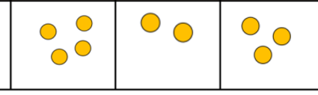

Multiplying decimals by 10
Answer:
What number is shown? 423.3
Draw the counters in the place value chart after moving them one place to the left.
Write down the answer: 4233

Slide 51
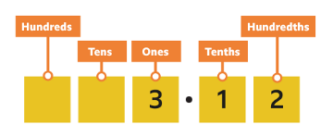
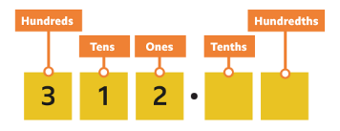
Multiply decimals by 100
To multiply by 100, you move the digits two places to the left.
Let’s look at an example:
3.12 x 100 = 312
To multiply by 100, you move the digits two places to the left. So 3.12 × 100 = 312.

Slide 52

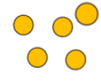


Multiplying decimals by 100
The number represented is 5.41.
When we x100, each digit moves two places to the left.
The answer is 541

Slide 53
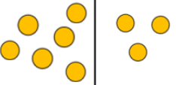

Multiplying decimals by 100
The number represented is ____.
When we x100, each digit moves two places to the left.
The answer is ___

Slide 54
Multiplying decimals by 100
Let’s check:
The number represented is 63.02.
When we x100, each digit moves two places to the left.
The answer is 6302

Slide 55


Multiplying decimals by 100
The number represented is ____.
When we x100, each digit moves two places to the left.
The answer is ___

Slide 56
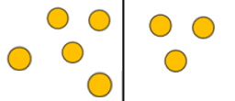
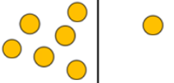
Multiplying decimals by 100
Let’s check:
The number represented is 53.61.
When we x100, each digit moves two places to the left.
The answer is 5361.

Slide 57
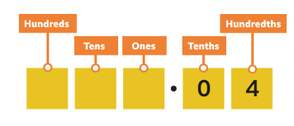
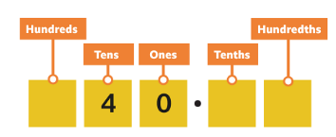
Multiplying decimals by 1000
To multiply by 1000, you move the digits three place value places to the left.
0.04 × 1000 = 40
To multiply by 1000, you move the digits three place value places to the left. So 0.04 × 1000 = 40.

Slide 58
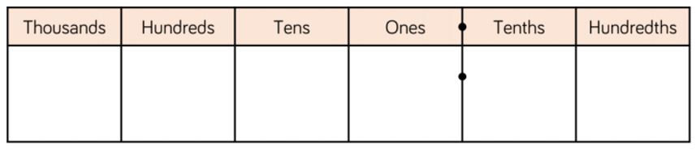
Multiplying decimals by 1000
Create or write the number 81.25
X it by 1000
Move each digit 3 places to the left.
Answer:
8 1 2 5

Slide 59
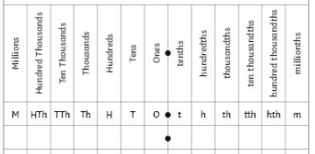
Multiplying decimals by 1000
Create or write the number 81.25
X it by 1000
Move each digit 3 places to the left.
Answer:
8 1 2 5
81,250

Slide 60
Multiplying decimals by 1000
34.1 x 1000 =

Slide 61
Multiplying decimals by 1000
34.1 x 1000 = 34,100
Each digit has moved 3 places to the left. As there are only 3 digits in 34.1 we have added the zeros to the tens and ones columns.

Slide 62
L.O: To be able to multiply decimal numbers
Copy down the calculations and write the answers. You can use place value charts and counter (or draw in the counters) to help you.
23.42 x 10 =
39.01 x 10 =
52.12 x 100 =
75.39 x 100 =
467. 219 x 10 =
321.012 x 100 =
56.12 x 1000 =
39.064 x 1000 =

Slide 63
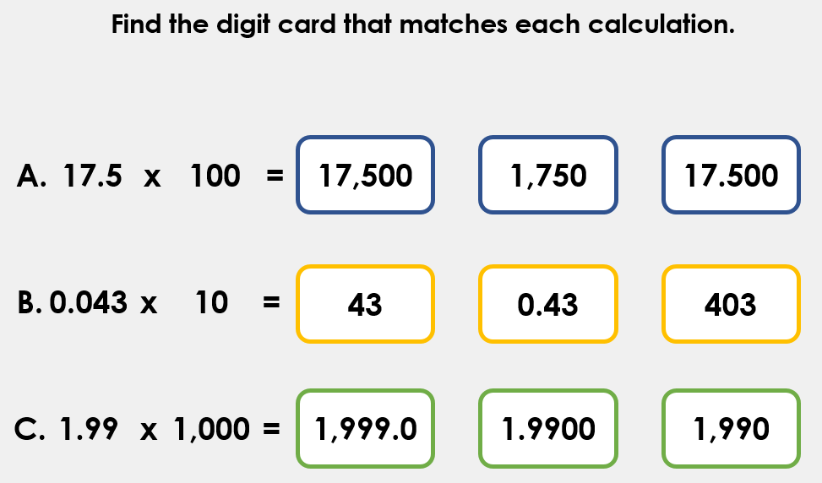
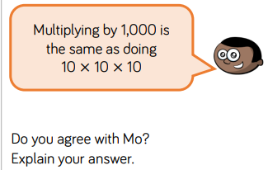
Extension:

Slide 64
L.O: To be able to multiply decimal numbers
Check your answers and make any corrections needed.
23.42 x 10 = 234.2
39.01 x 10 = 390.1
52.12 x 100 = 5212
75.39 x 100 = 7539
467. 219 x 10 = 4672.19
321.012 x 100 = 32,101.2
56.12 x 1000 = 56,120
39.064 x 1000 = 39,064

Slide 65
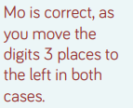
Extension:

Slide 66
Times-table practise
Spend at least 15mins practising your times-tables.
This can be done on TTRS, hit the button or any other times-table website.
Use the Times-Tables Rock Stars app or website.
Alternatively, copy and paste the following link into a web browser:
https://play.ttrockstars.com/auth/school/student/73173
https://www.topmarks.co.uk/maths-games/7-11-years/times-tables

Slide 67
End of Lesson

Slide 68
Date: 04.03.21
L.O: To be able to divide numbers.
Subject: Maths

Slide 69
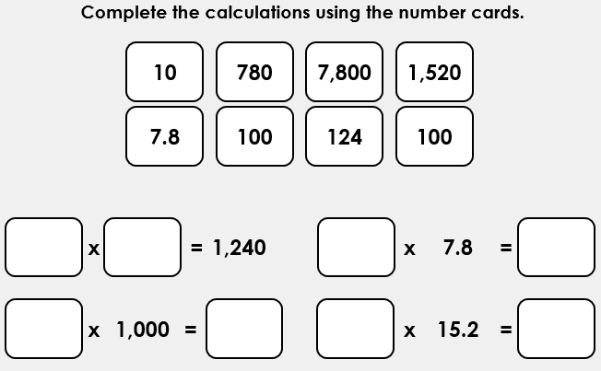
Mental Starter: x Decimals

Slide 70
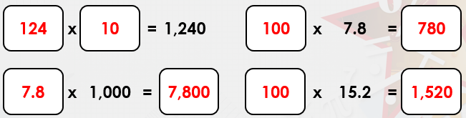
Answer:

Slide 71
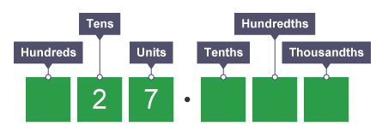
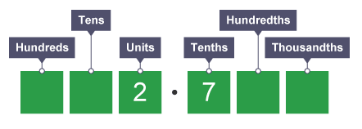
Dividing by 10
When you divide by 10, each digit moves one place to the right. Hundreds become tens, tens become units, units become tenths and tenths become hundredths.
For example:
27 ÷ 10 = 2.7
Each digit has moved 1 place to the right.

Slide 72
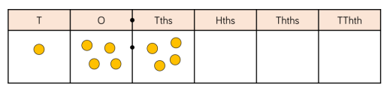


Dividing by 10
When dividing decimal numbers, we follow the same approach.
Each digit moves 1 place to the right.
E.G 14.4 ÷ 10 = 1.44

Slide 73
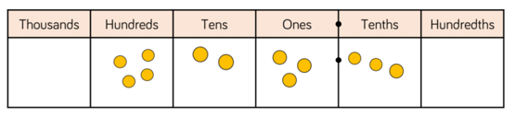






Dividing by 10
What number is shown?
______
Divide the number by 10
Move each digit 1 place to the right.
Answer:_________

Slide 74
Let’s check:
What number is shown?
423.3
Divide the number by 10
Move each digit 1 place to the right.
Answer: 42.33

Slide 75
Dividing by 10
Create the number in one place value chart.
Move the digits one place to the right and draw in the new position on the next chart.
Try these:
134 ÷ 10 =
28.9 ÷ 10 =
You can use the place value charts to help you.

Slide 76
Dividing by 10
Answers:
134 ÷ 10 = 13.4
28.9 ÷ 10 = 2.89
Each digit has moved one place to the right.

Slide 77
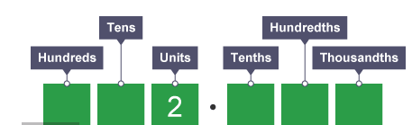
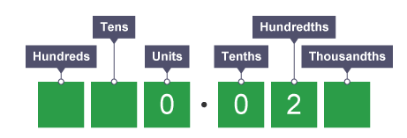
Dividing by 100
When you divide by 100, each digit moves two places to the right.
Each digit moves 2 places to the
right. We don't have any units and
tenths, so we place a '0' in the
columns.
Therefore 2 ÷ 100 = 0.02

Slide 78
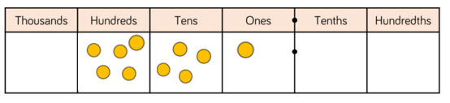



Dividing by 100
When dividing decimal numbers, we follow the same approach.
Each digit moves 2 places to the right.
E.G 541.2 ÷ 100 =
5.412
Thousandths

Slide 79

Dividing by 100
Create the number 245.6
Move each digit 2 places to the right and place the counters into the new columns.
Answer: _____

Slide 80





Dividing by 100
Create the number 244.5
Move each digit 2 places to the right and place the counters into the new columns.
Answer: 2.445

Slide 81

Dividing by 100
Create the number
162.8
Move each digit 2 places to the right
Answer: _________

Slide 82
Dividing by 100
Answers:
162.8 ÷ 100 = 1.628
Each digit has moved two places to the right.

Slide 83


Dividing by 1000
When you divide by 1,000, each digit moves three places to the right.
Each digit moves 3 places to the right. We don't have any units and tenths, so we use '0' in each column.
A zero in the thousandths column is not needed so we ignore it.
Therefore 30 ÷ 1,000 = 0.03

Slide 84
Dividing by 1000
Create the number 4293.1
Move each digit 3 to the right
Answer: _________

Slide 85
Dividing by 1000
Create the number 4293
Move each digit 3 to the right
Answer: 4.293
4 2 9 3
4 2 9 3

Slide 86
Dividing by 1000
6382.92 ÷ 1000 =
8451.2 ÷ 1000 =
Remember, each digit moves three places to the right.

Slide 87
Dividing by 1000
6382.92 ÷ 1000 = 6.38292
8451.2 ÷ 1000 = 8.4512

Slide 88

L.O: To be able to divide numbers
Copy down the calculations and write the answers. You can use place value charts, which are on the following slides, and counters (or draw in the counters) to help you.
24 ÷ 10 =
312 ÷ 100 =
885.2 ÷ 10 = Extension:
240.9 ÷ 100 =
673.07 ÷ 10 =
491.55 ÷ 100 =
9054.2 ÷ 1000=
1232.05 ÷ 1000 =

Slide 91
L.O: To be able to divide numbers
Answers:
24 ÷ 10 = 2.4
312 ÷ 100 = 3.12
885.2 ÷ 10 = 88.52 Extension:
240.9 ÷ 100 = 2.409
673.07 ÷ 10 = 67.307
491.55 ÷ 100 = 4.9155
9054.2 ÷ 1000= 9.0542
1232.05 ÷ 1000 = 1.23205
100
541
19.3

Slide 92
Times-table practise
Spend at least 15mins practising your times-tables.
This can be done on TTRS, hit the button or any other times-table website.
Use the Times-Tables Rock Stars app or website.
Alternatively, copy and paste the following link into a web browser:
https://play.ttrockstars.com/auth/school/student/73173
https://www.topmarks.co.uk/maths-games/7-11-years/times-tables

Slide 93
End of Lesson

Slide 94
Date: Friday 5th March 2021
L.O To be able to identify your own feelings
Subject: PSHE

Slide 95

We are looking forward to seeing you all back at school on Monday.
It is normal to have mixed emotions about returning to school after a long break.
Excited
Enthusiastic
You might be feeling….
Happy
Relieved
Sad
Nervous

Slide 96

Look at the ‘Feeling blob tree’ and colour in one blob person which you think might show how you are feeling.
It would be good to talk to someone about about how you are feeling.

Slide 97



We want you to feel happy and relaxed about coming back to
school so you can concentrate on your work.
Spend some time today doing activities that you enjoy.
Play a game
Go for a walk
Read a book

Slide 98



We want you to feel happy and relaxed about coming back to
school so you can concentrate on your work.
Spend some time today doing activities that you enjoy.
Ride your bike or scooter
Watch a film
Make a cake

Slide 99


Have a lovely weekend
See you Monday

