Slide 1



Date: Monday 1st March 2021
LO: To be able to explain the importance of good personal hygiene in the kitchen.
Subject: Technology

Slide 2
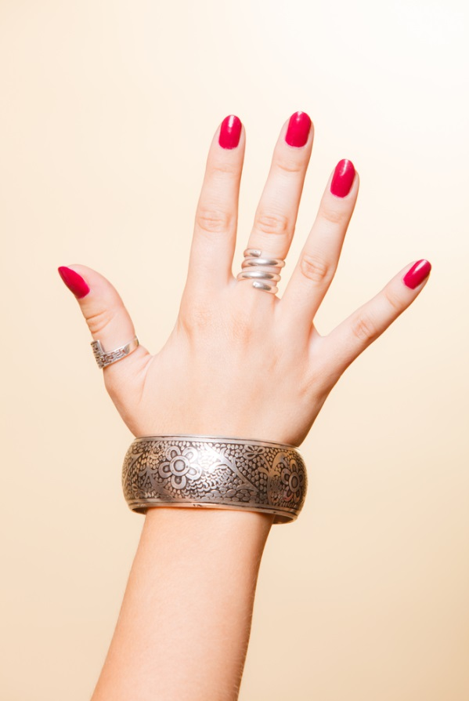

Why is personal hygiene important?
Bacteria live in and on your own body and can enter into food in the home if you do not have high standards of personal hygiene.
Your hands, hair, face, skin, clothing and jewellery can all be a source of bacteria which can be transferred onto food. This is known as cross-contamination.

Slide 3
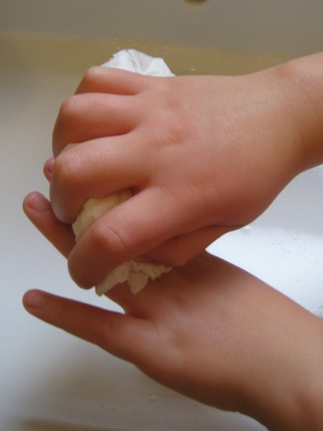
Hands
Your hands may look clean but you
cannot see the bacteria that cause food poisoning. Therefore, it is important to wash hands thoroughly at these times:
Before starting to prepare food;
After touching raw meat, fish or poultry;
After touching raw egg;
After going to the toilet;
After touching the bin;
After touching pets.
Always wash your hands before you start cooking.
This stops any germs that might have been on your hands from getting into the food.

Slide 4

Six steps to effective hand washing
Wet hands thoroughly and squirt liquid soap (preferably anti-bacterial) onto the palm of one hand.
Rub your hands together to make a lather.
Rub the palm of one hand along the back of the other and along the fingers. Then repeat with the other hand.
Rub in between each of your fingers on both hands and round your thumbs.
Rinse off the soap with clean hot water.
Dry hands thoroughly using clean paper towels.

Slide 5
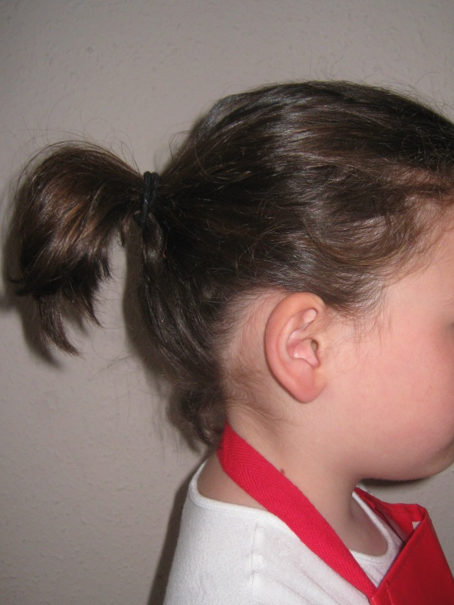
Hair
Bacteria can also live on your hair and scalp. Bacteria can easily transfer from your hair into the food. To prevent this:
Long hair should be tied back;
This stops any stray hairs from getting in the food and infecting it.

Slide 6
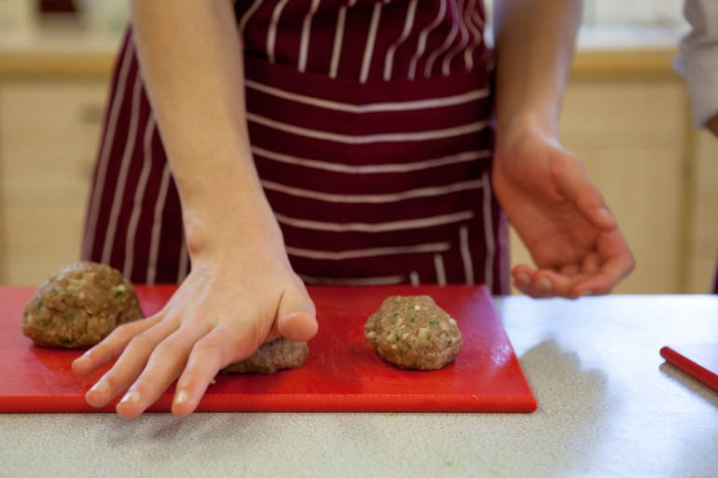
Skin
Cuts and wounds can be infected with bacteria.
In order to prevent harmful bacteria contaminating your food, cuts and wounds should be covered with a waterproof dressing such as a plaster.

Slide 7
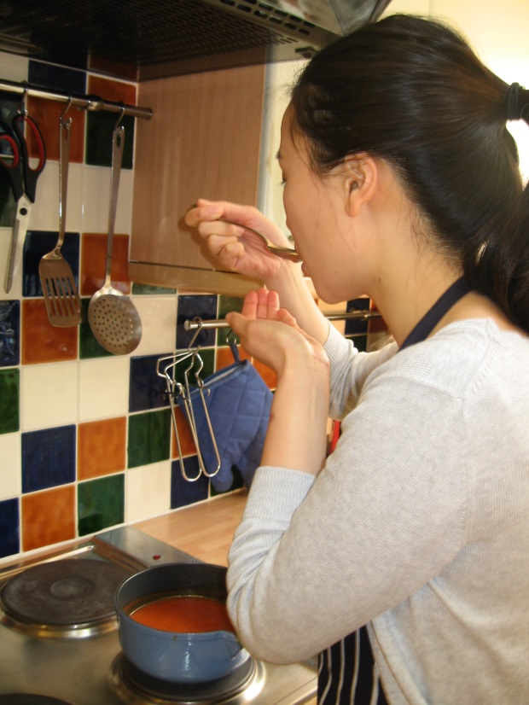
Face
Hands can pick up harmful bacteria from your face or mouth. To prevent bacteria transferring onto your food:
Do not taste food with fingers, or ‘double dip’ using the same spoon;
Avoid coughing or sneezing over food;
Do not bite your nails or lick your fingers whilst cooking.

Slide 8
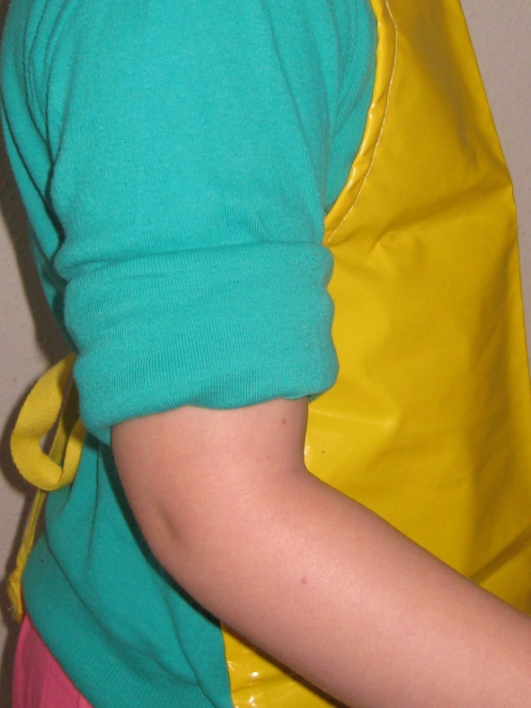
Clothing and jewellery
Bacteria and dirt can be on your clothes, jewellery and watches.
Roll up long sleeves and wear a clean apron;
Remove any jewellery that may dangle into food along with rings with stones in and watches if you are making dishes such as bread or pastry.
This is to prevent food being contaminated:

Slide 9
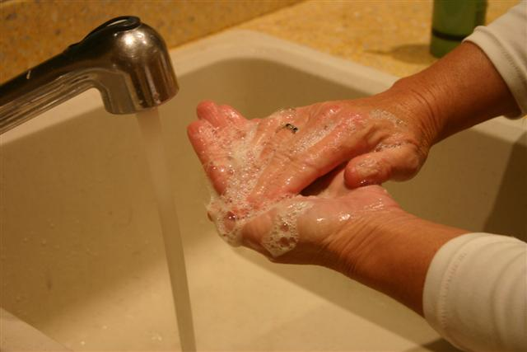




LO: To be able to explain the importance of good personal hygiene in the kitchen.
Your task!
Write down a set of rules for each of the pictures to explain how to use personal hygiene in the kitchen and why.
1
3
2
4

Slide 10
Write down a set of rules for each of the pictures to explain how to use personal hygiene in the kitchen and why.
_______________________________________________________________________________________________________________________________________________________________________________________________________________________________________________________________________________________________________________________________________________________________________________________________________________________
___________________________________________________________________________________________________________________________________________________________________________________________________________
__________________________________________________________________________________________________________________________________________________________________________________________________________________________________________________________________________________________________________________

Slide 11
Write down a set of rules for each of the pictures to explain how to use personal hygiene in the kitchen and why.
_______________________________________________________________________________________________________________________________________________________________________________________________________________________________________________________________________________________________________________________________________________________________________________________________________________________
___________________________________________________________________________________________________________________________________________________________________________________________________________
__________________________________________________________________________________________________________________________________________________________________________________________________________________________________________________________________________________________________________________

Slide 12
Write down a set of rules for each of the pictures to explain how to use personal hygiene in the kitchen and why.
_______________________________________________________________________________________________________________________________________________________________________________________________________________________________________________________________________________________________________________________________________________________________________________________________________________________
___________________________________________________________________________________________________________________________________________________________________________________________________________
__________________________________________________________________________________________________________________________________________________________________________________________________________________________________________________________________________________________________________________

Slide 13
Write down a set of rules for each of the pictures to explain how to use personal hygiene in the kitchen and why.
_______________________________________________________________________________________________________________________________________________________________________________________________________________________________________________________________________________________________________________________________________________________________________________________________________________________
___________________________________________________________________________________________________________________________________________________________________________________________________________
__________________________________________________________________________________________________________________________________________________________________________________________________________________________________________________________________________________________________________________

Slide 14
End of Lesson

Slide 15

Date: Tuesday 2nd March 2021
LO: To be able to create and use strong and secure passwords.
Subject: E-safety

Slide 16

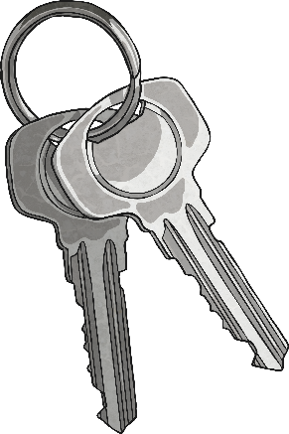
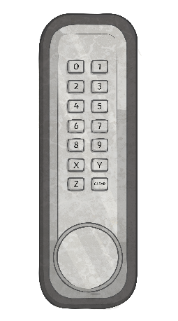
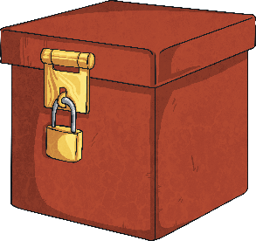
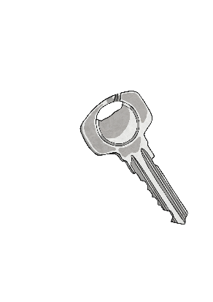
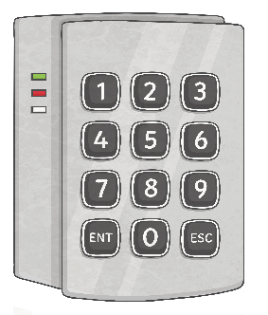

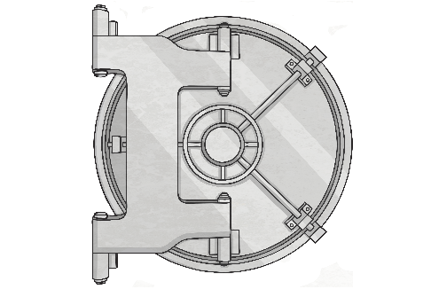

Stay Secure
Think about all the ways you keep your homes and belongings safe.
You wouldn’t give people the key or combination to a lock, would you?

Slide 17
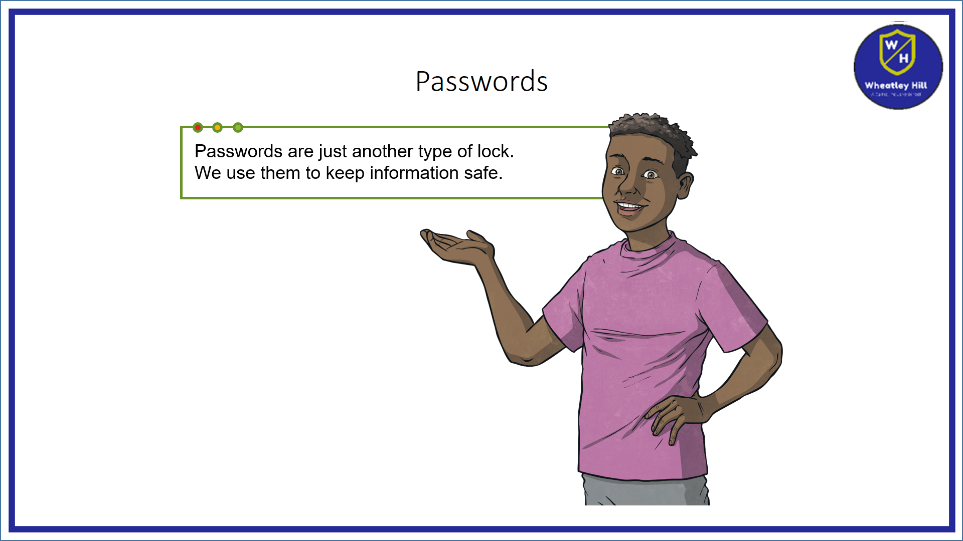

Slide 18
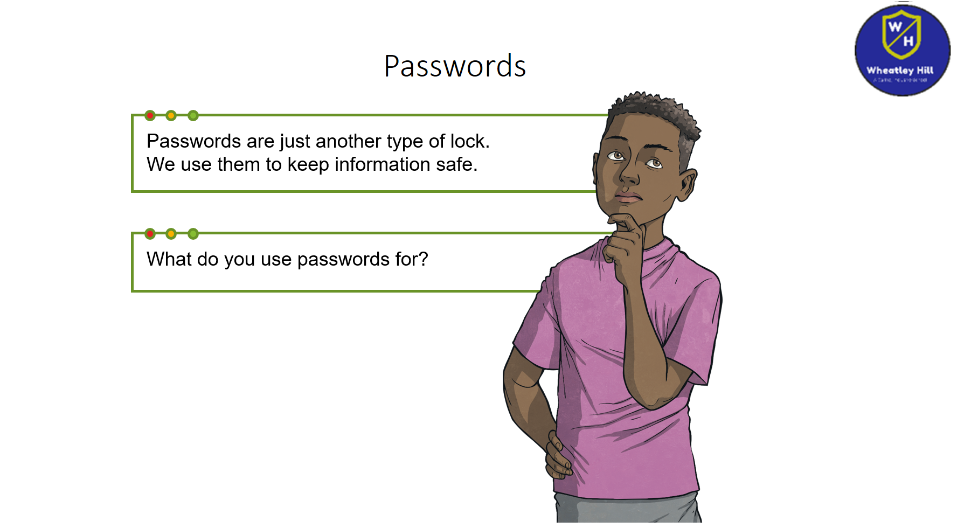

Slide 19
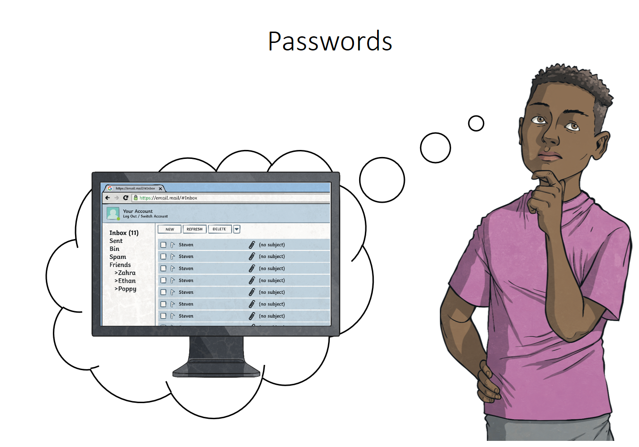

Slide 20
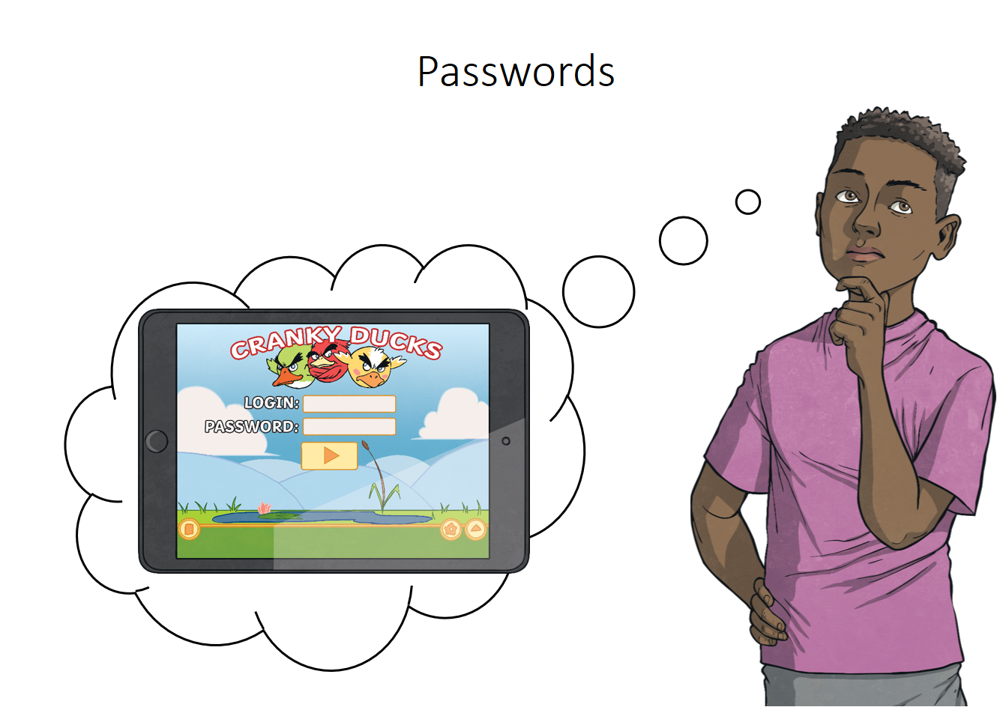

Slide 21
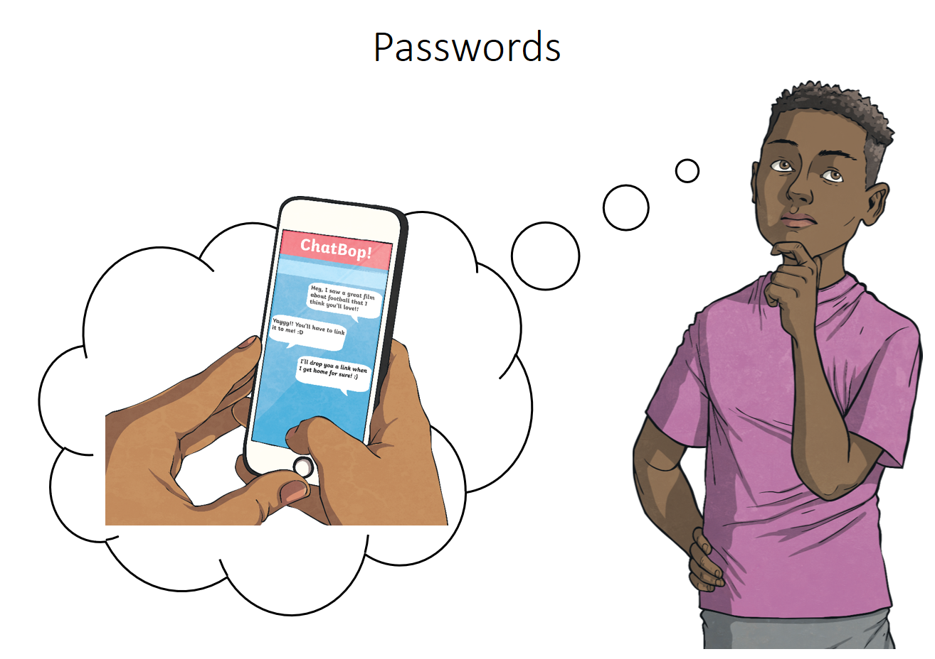

Slide 22
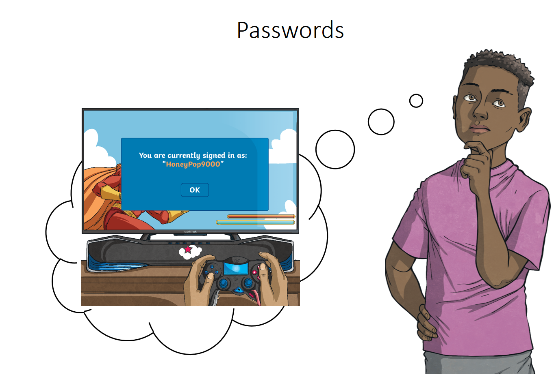

Slide 23
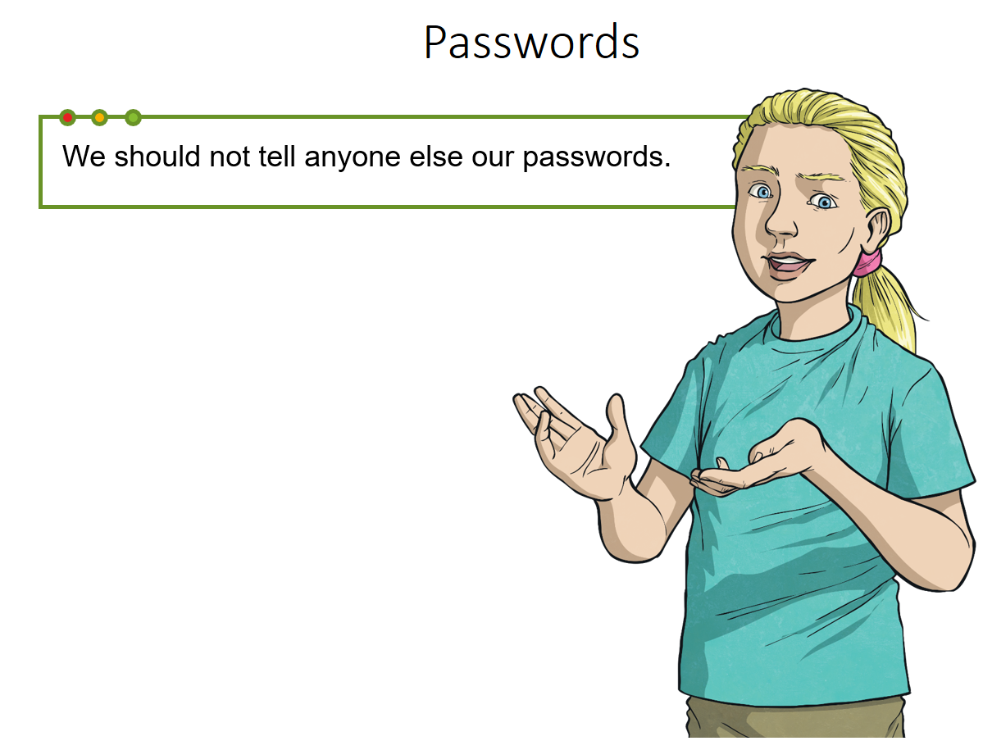

Slide 24
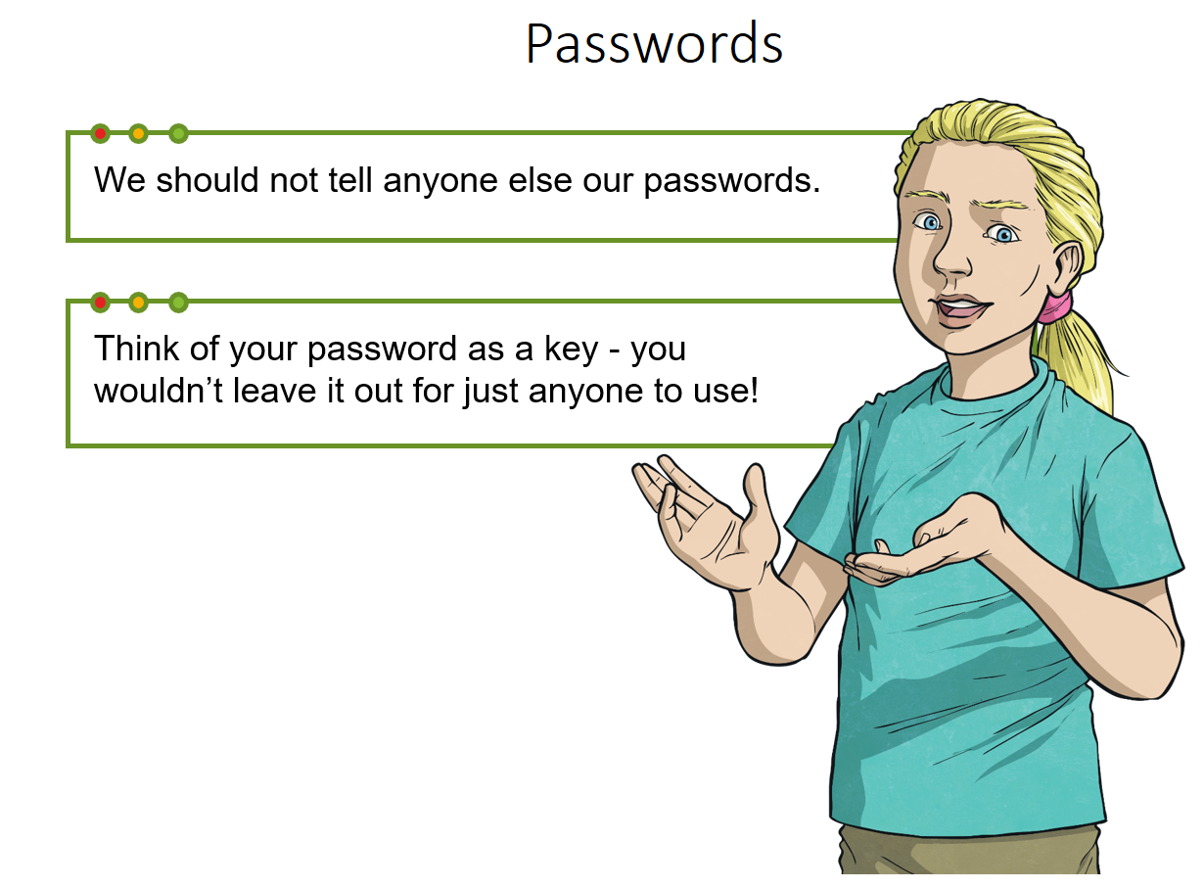

Slide 25
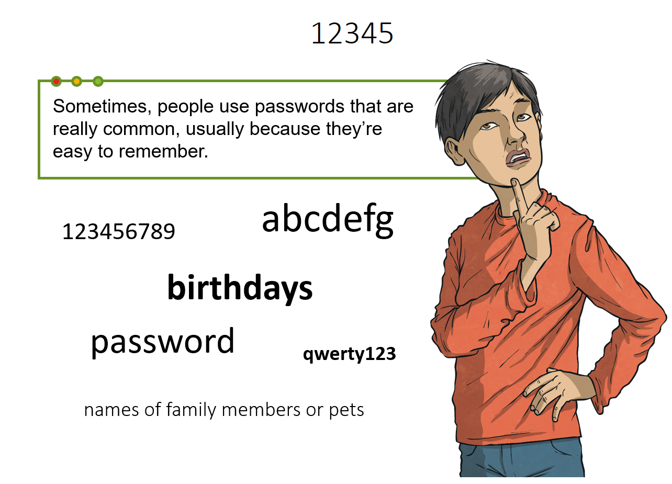

Slide 26
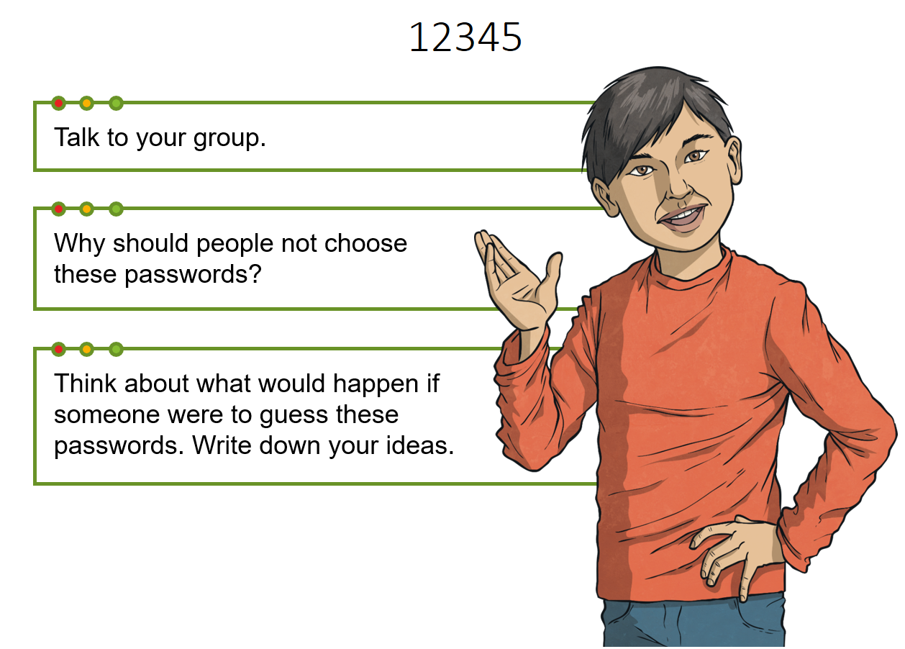
Is this a good idea?

Slide 27
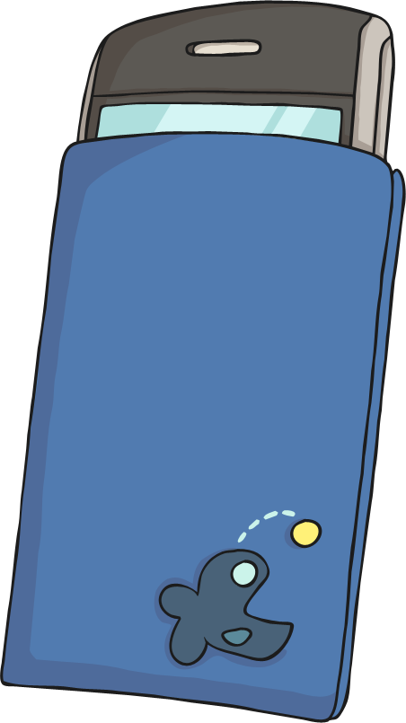
Rules
There are some basic rules you can follow to create a really strong password.
Include both lower-case (abc) and upper-case (ABC) letters.
Include numbers (123).
Include other characters (like punctuation marks and symbols), e.g. ?&#£$!@
Avoid using full words.
Avoid using names or birthdays.

Slide 28
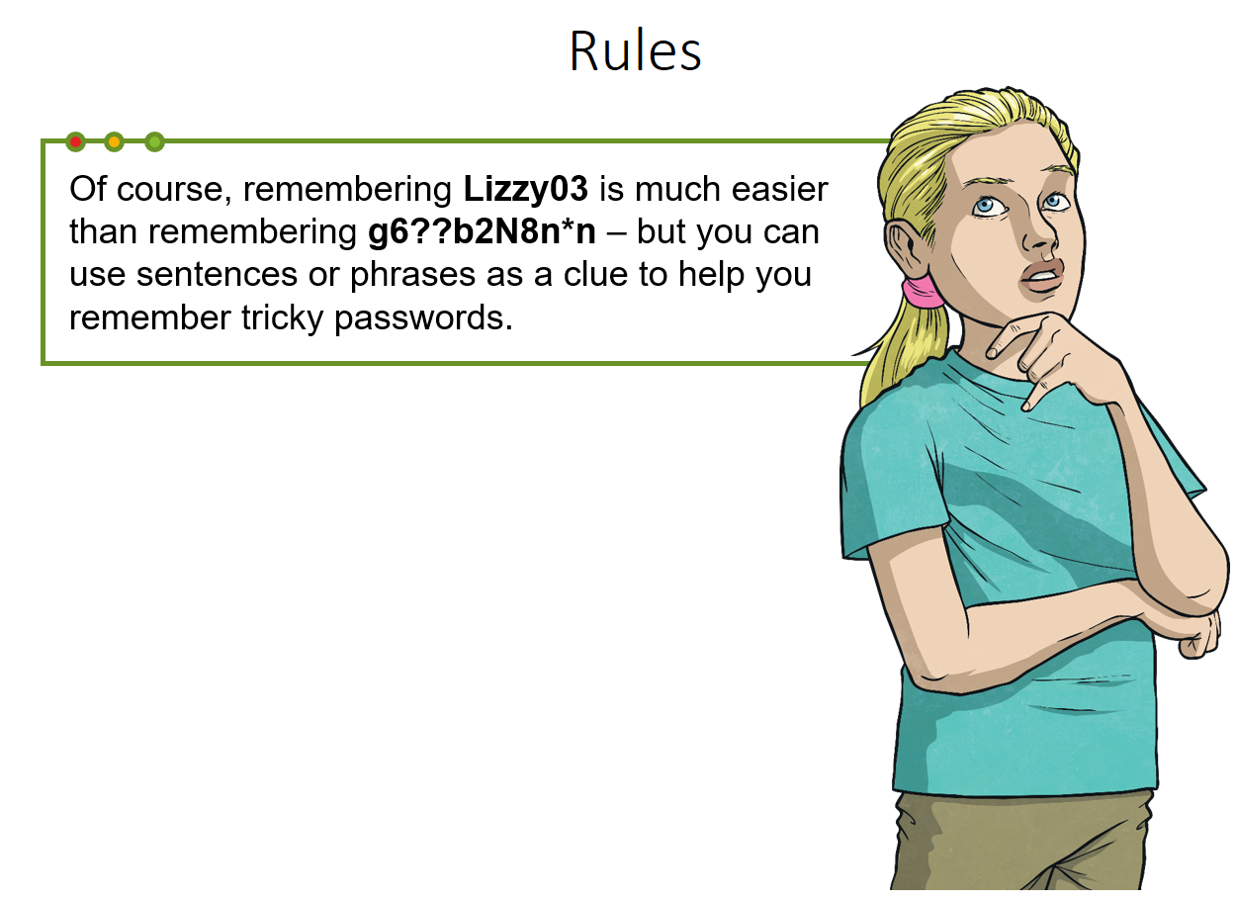

Slide 29
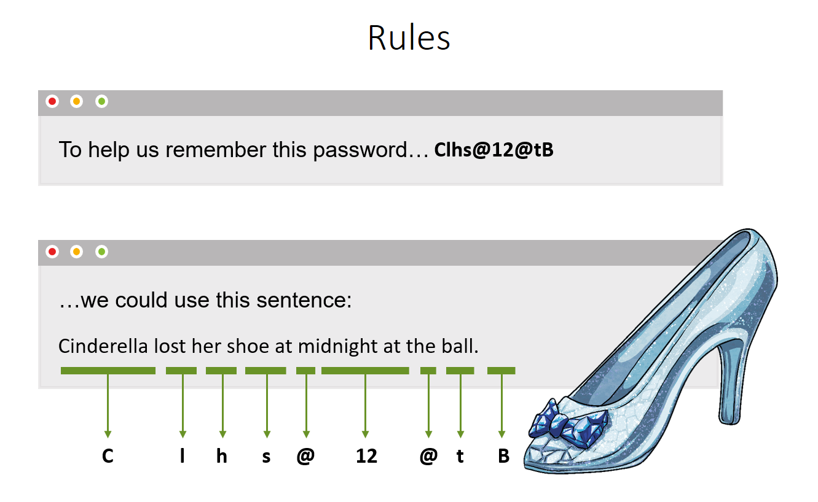

Slide 30
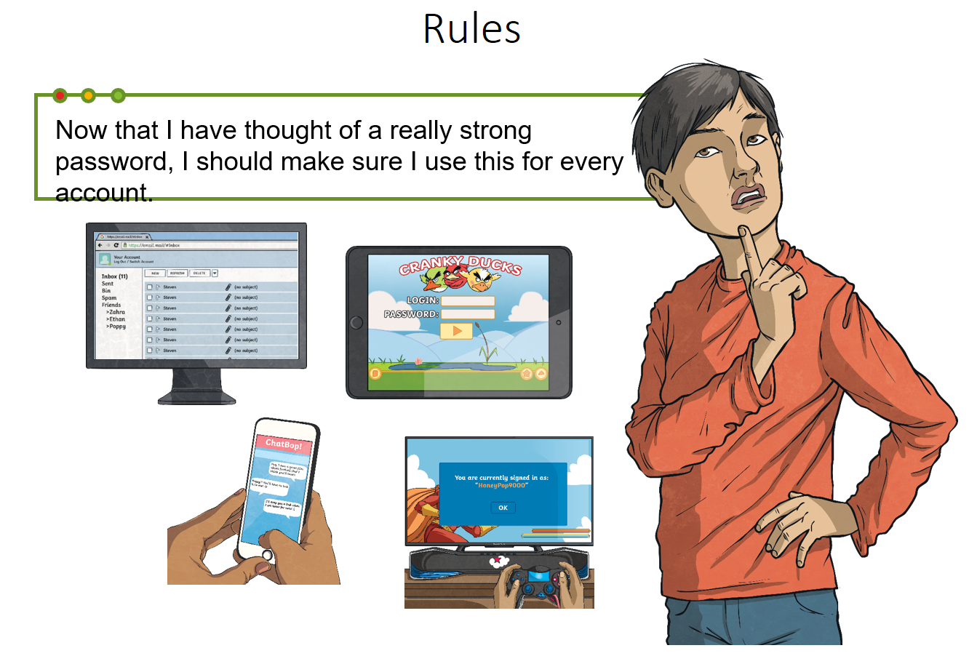

Slide 31
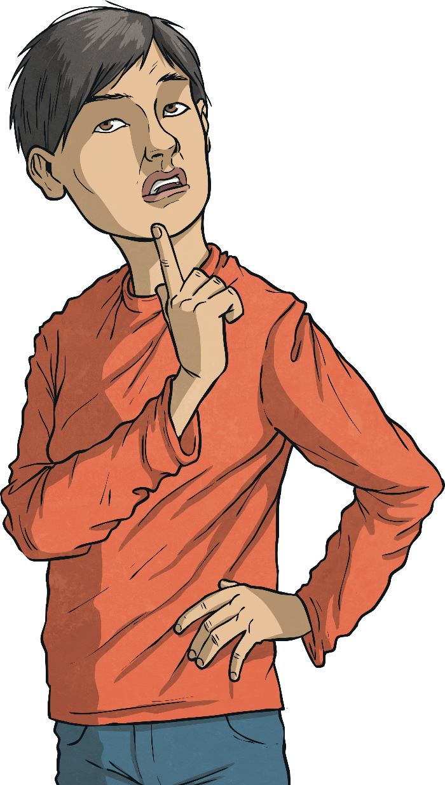
Rules
Now that I have thought of a really strong password, I should make sure I use this for every account.
If you use the same password for different logins, someone who guesses your password on one account can log in to all your accounts!
Use a different strong password for each of your accounts.

Slide 32
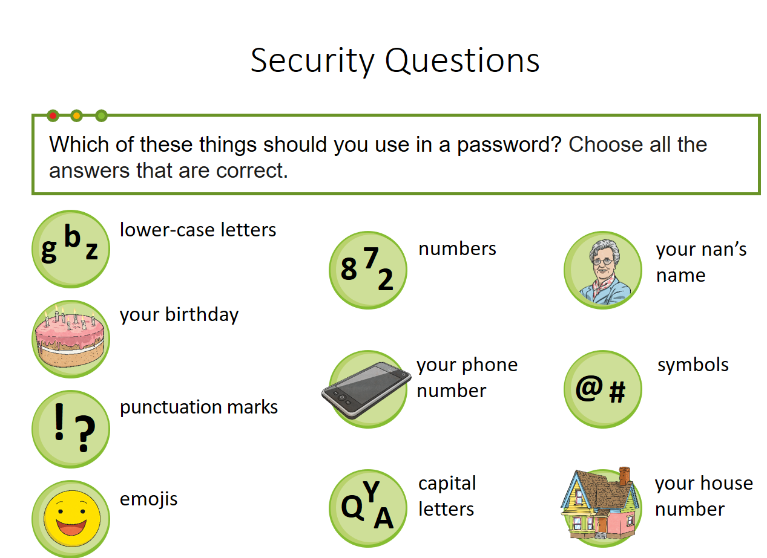

Slide 33
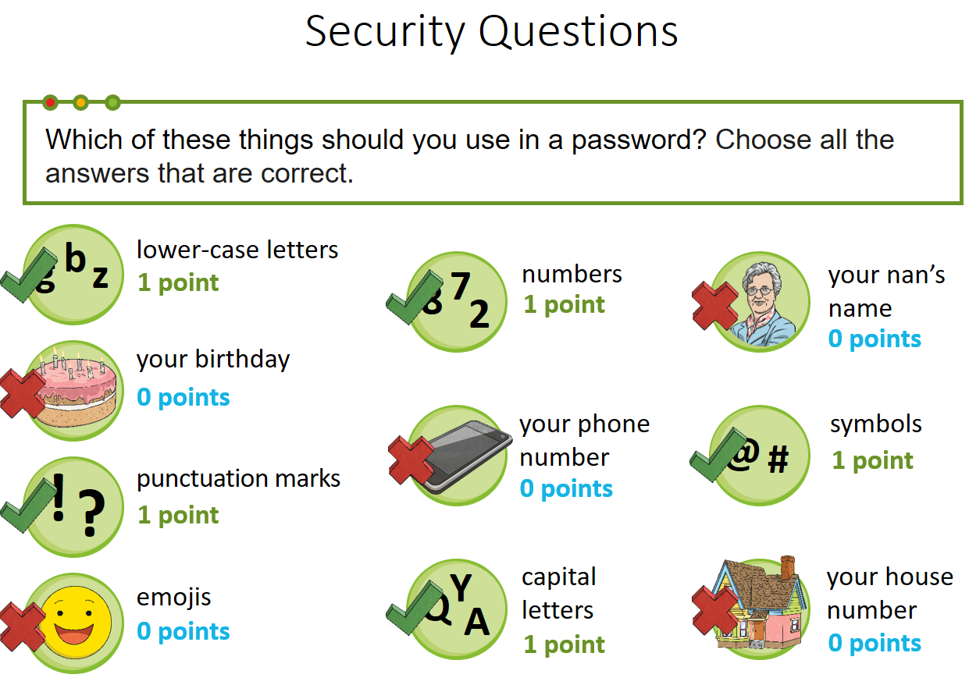

Slide 34
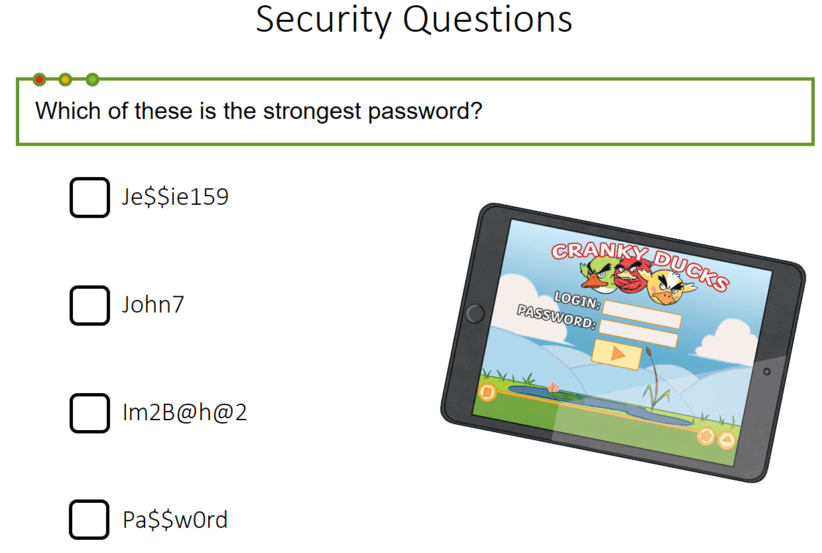

Slide 35
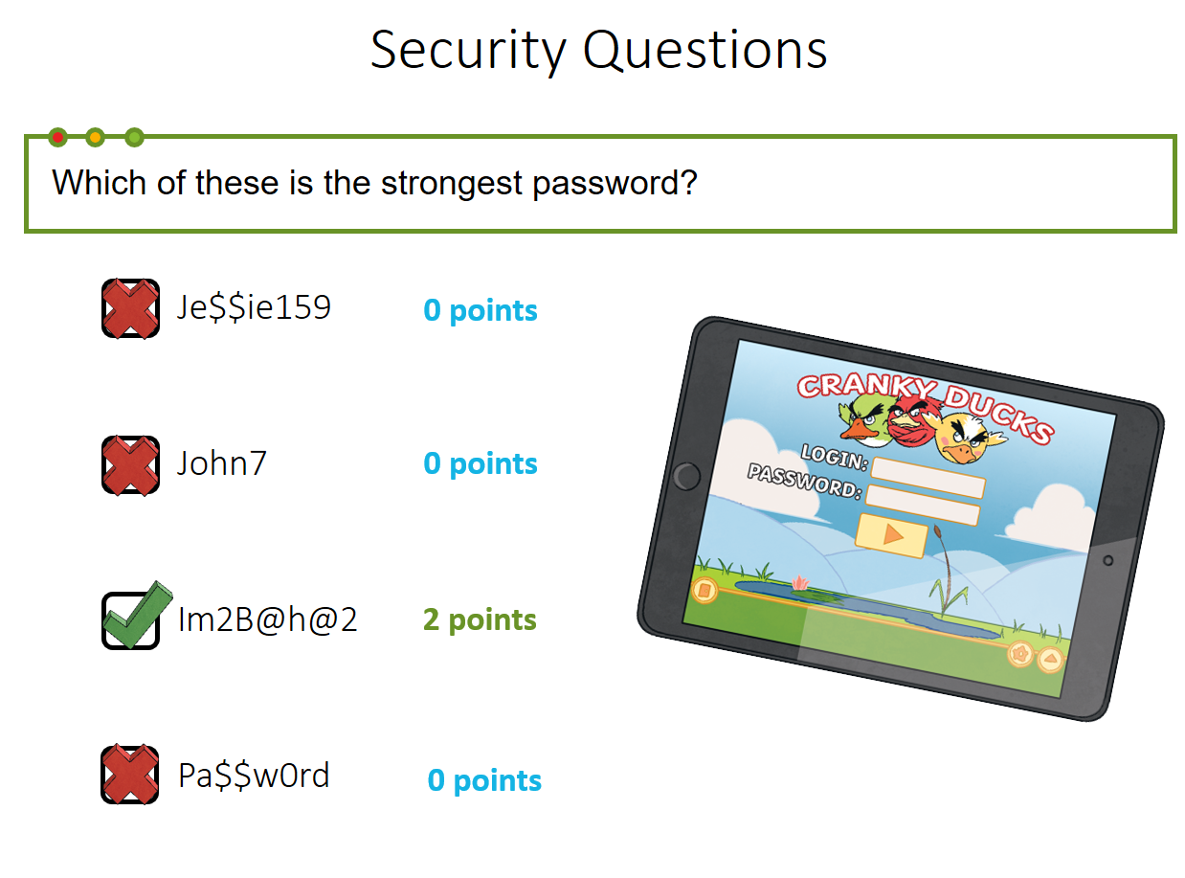

Slide 36
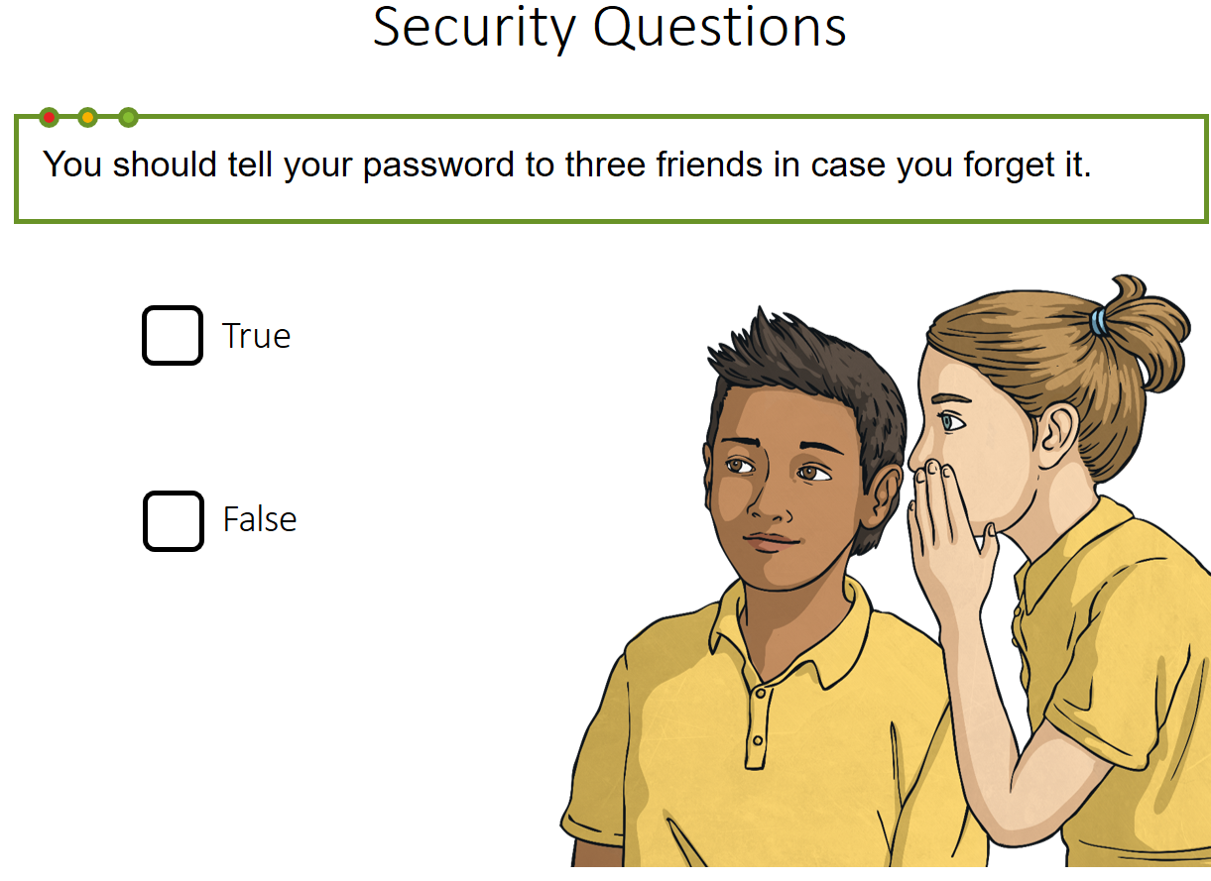

Slide 37
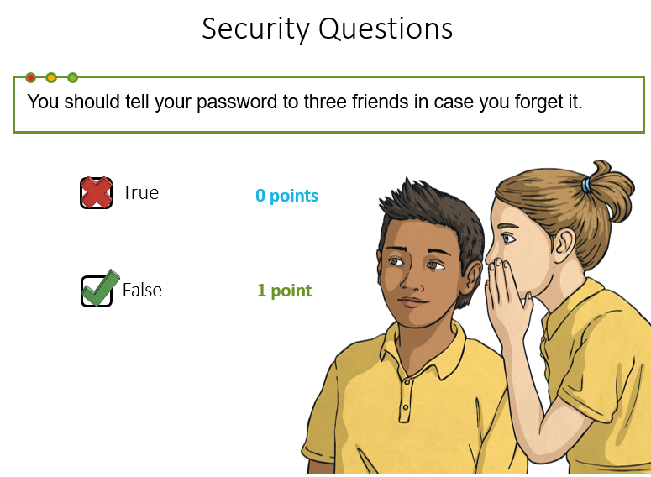

Slide 38
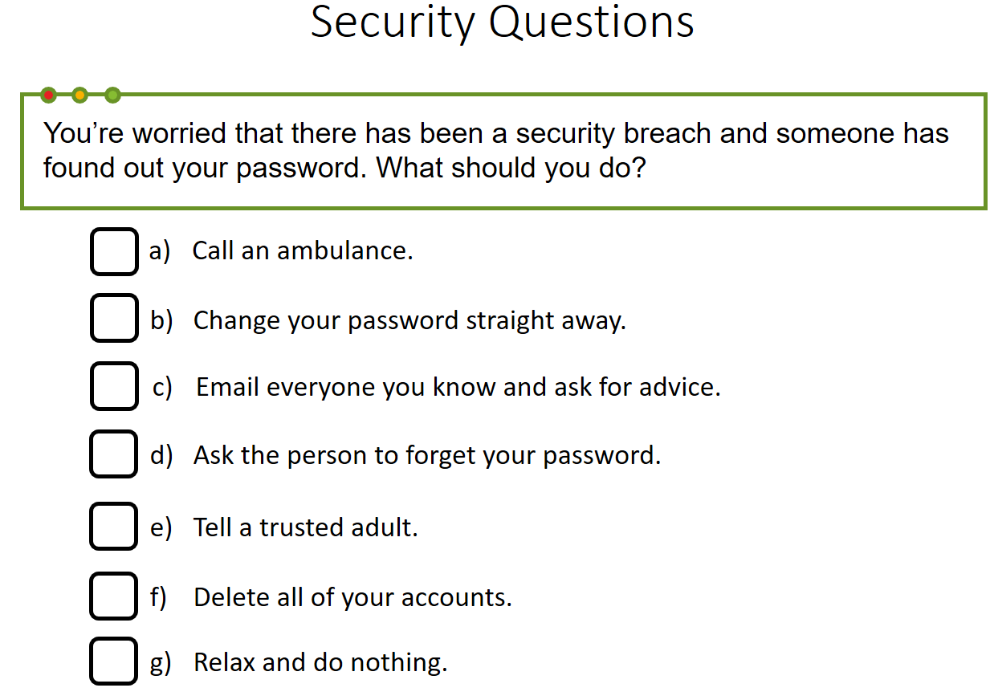

Slide 39
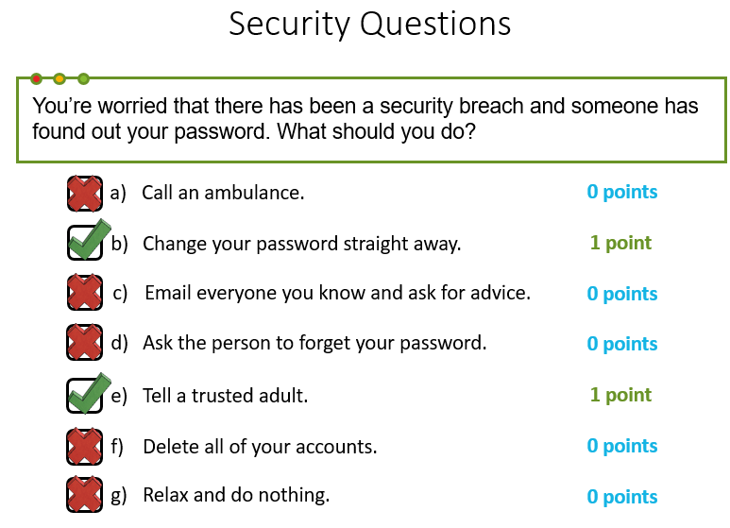

Slide 40
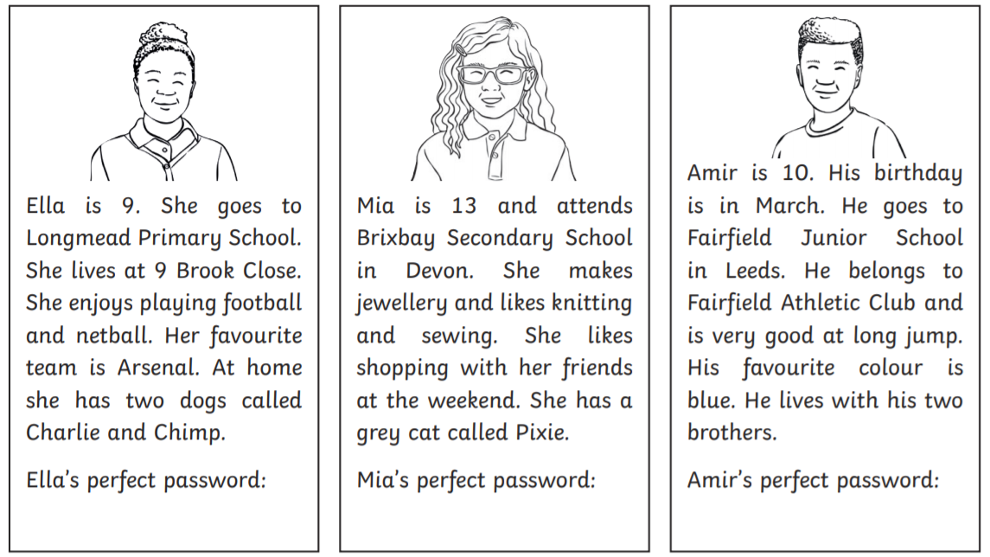
Task 1: Take a look at the profiles for Ella, Mia and Amir, below.
Using your knowledge of what makes a string password, can you create a password for each of the children?

Slide 41
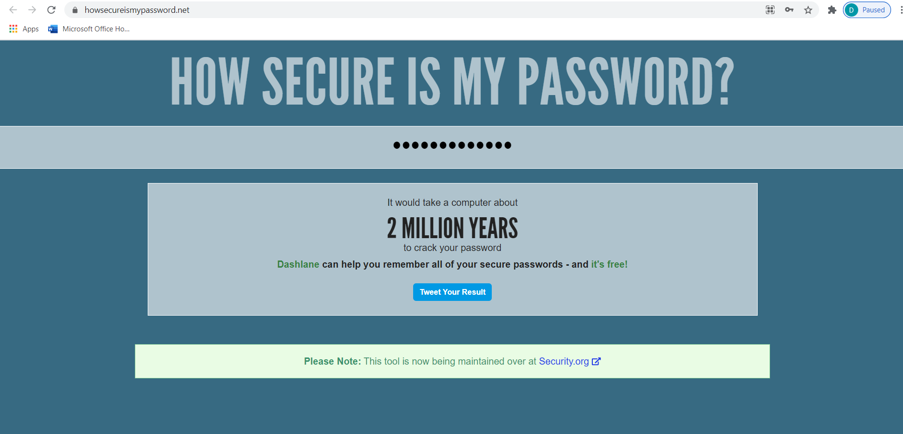
Task 2: If you have access to the internet, click on the link below and find out how secure your passwords are.
My password would take a computer around 2 million years to unlock. Can you beat it?
If you do not have access to the internet, see if you can think of some strong and secure passwords, for your devices/apps.
https://howsecureismypassword.net
Please do not send any of your own passwords back to us ☺

Slide 42
End of Lesson

Slide 43
Date: 03.03.2021
LO: To be able to complete a circuit of exercises and beat my personal best.
Subject: P.E

Slide 44
Today, we are going to complete an at-home P.E lesson.
The aim of this lesson is to improve our fitness, our flexibility, coordination and most importantly… to have some fun.
The following slides show the whole workout and instructions on how to complete each exercise.
The exercises have advice on how to make them easier or harder and you can complete the circuit as many times as you wish. If possible, however, try and complete this circuit at least 3 times, between now and next Wednesday.
One circuit takes 15 minutes with 30 second breaks between each exercise (however you can lengthen or shorten your rest, depending on how you feel or shorten the exercise down to 30 seconds – remember you are competing against yourself and no one else).
You should be able to complete this workout with very little equipment. Something small for the last exercise, so you can touch your toe on it and a soft enough floor will be all you need.
Included at the end of this presentation is a table for you to record how many of each exercise you managed to do within the minute.
Have fun!

Slide 45
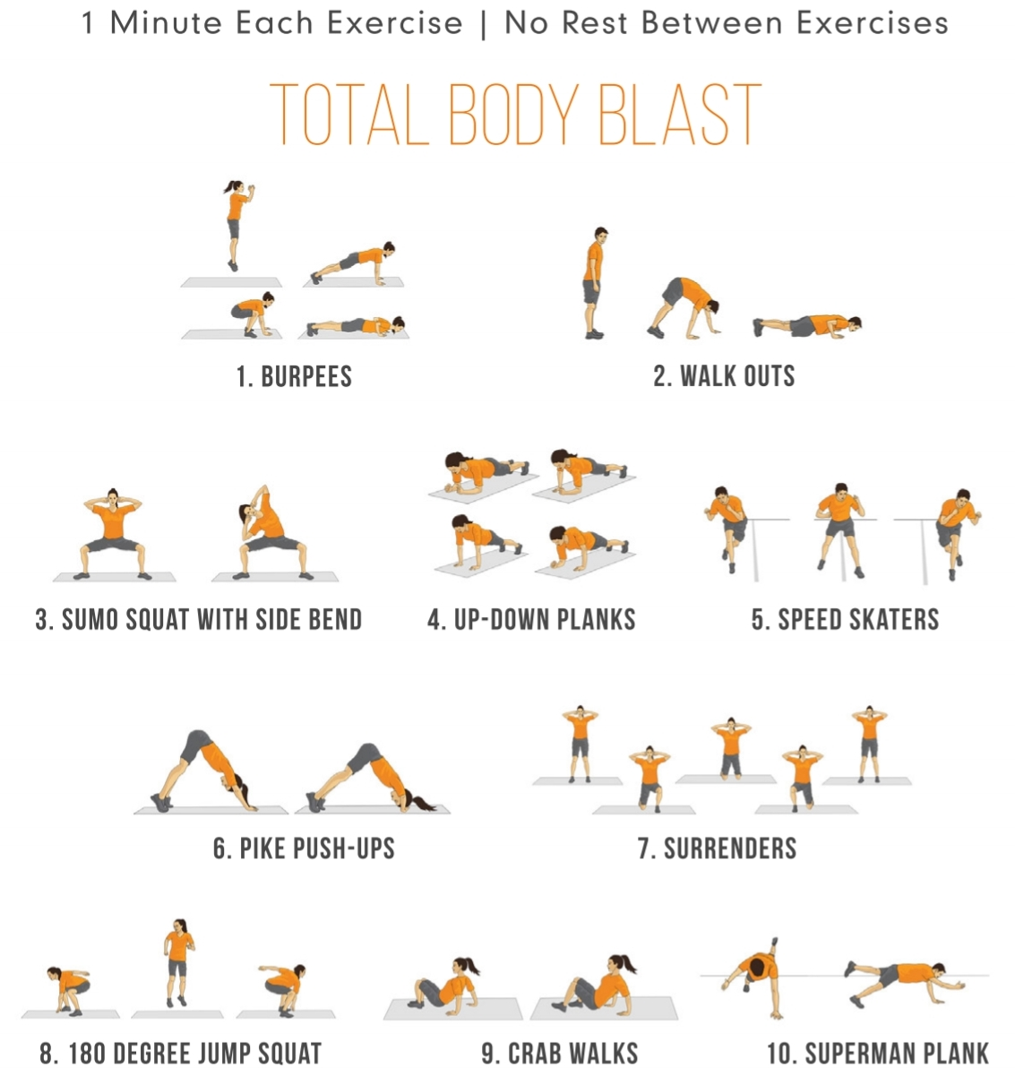

The workout
30secs rest between exercises

Slide 46
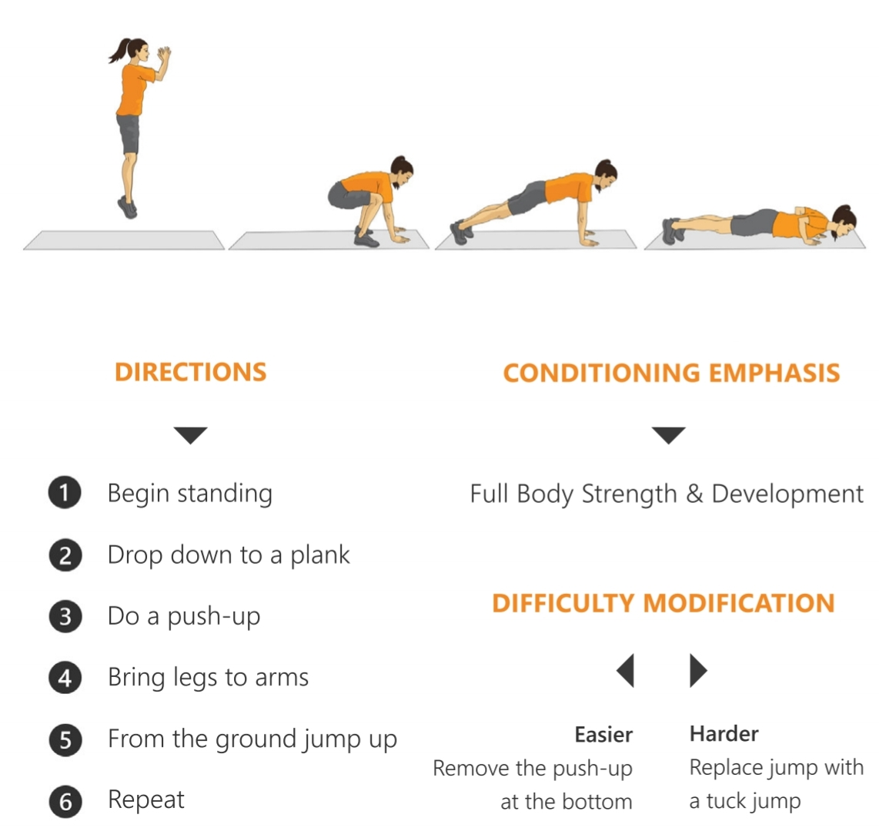
Burpees

Slide 47
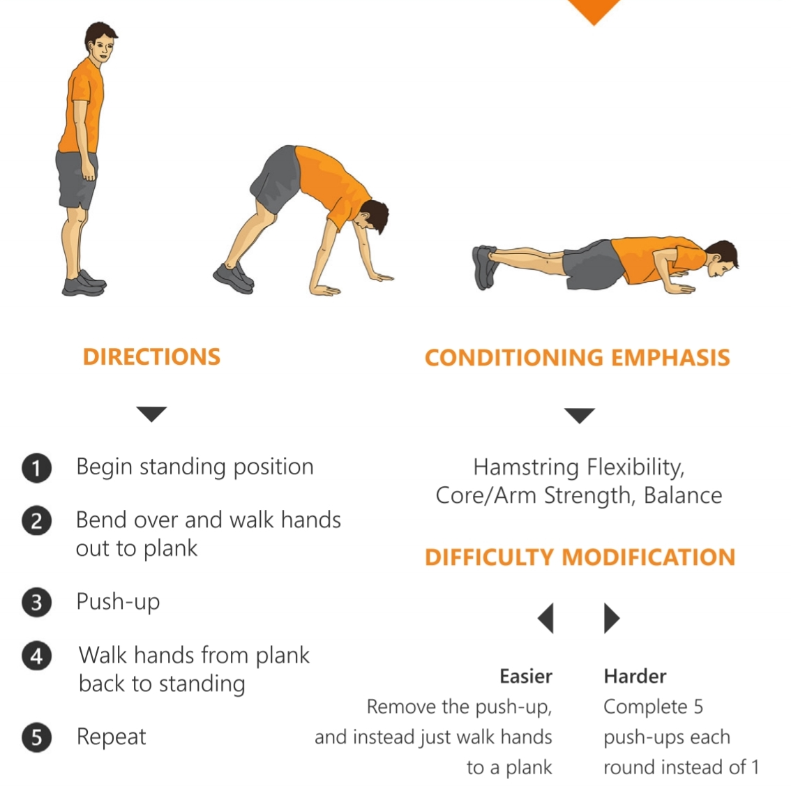
Walkouts

Slide 48
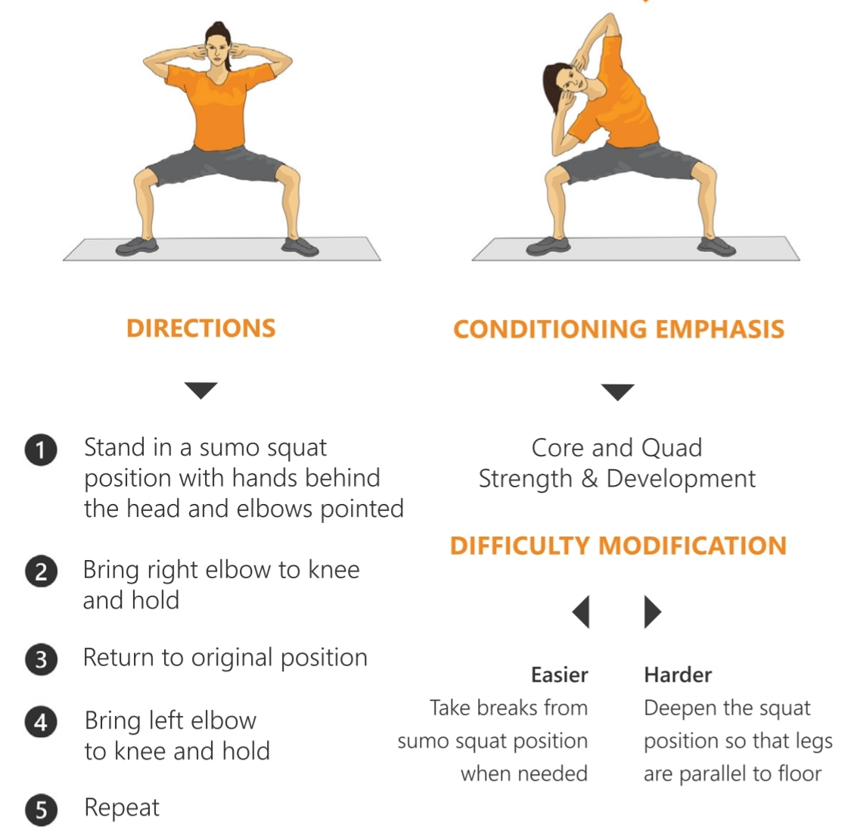
Sumo Squat with Side Bend

Slide 49
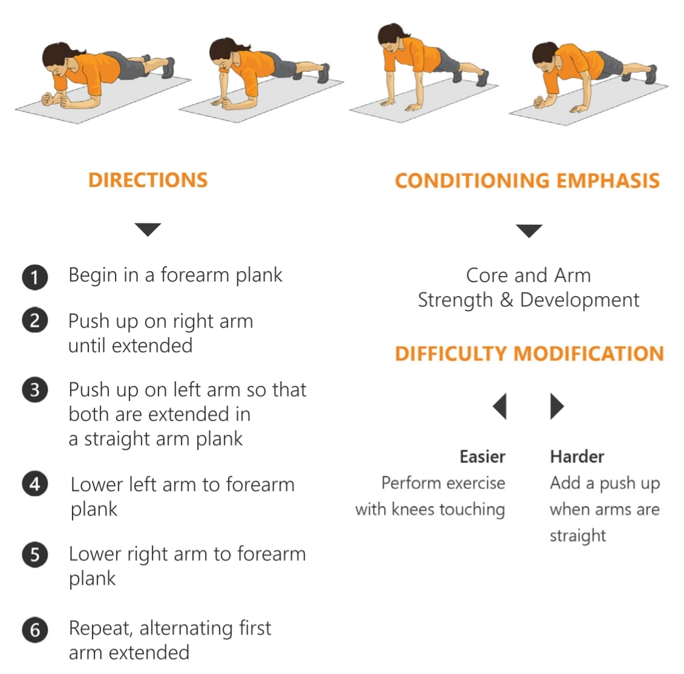
Up-down Plank

Slide 50
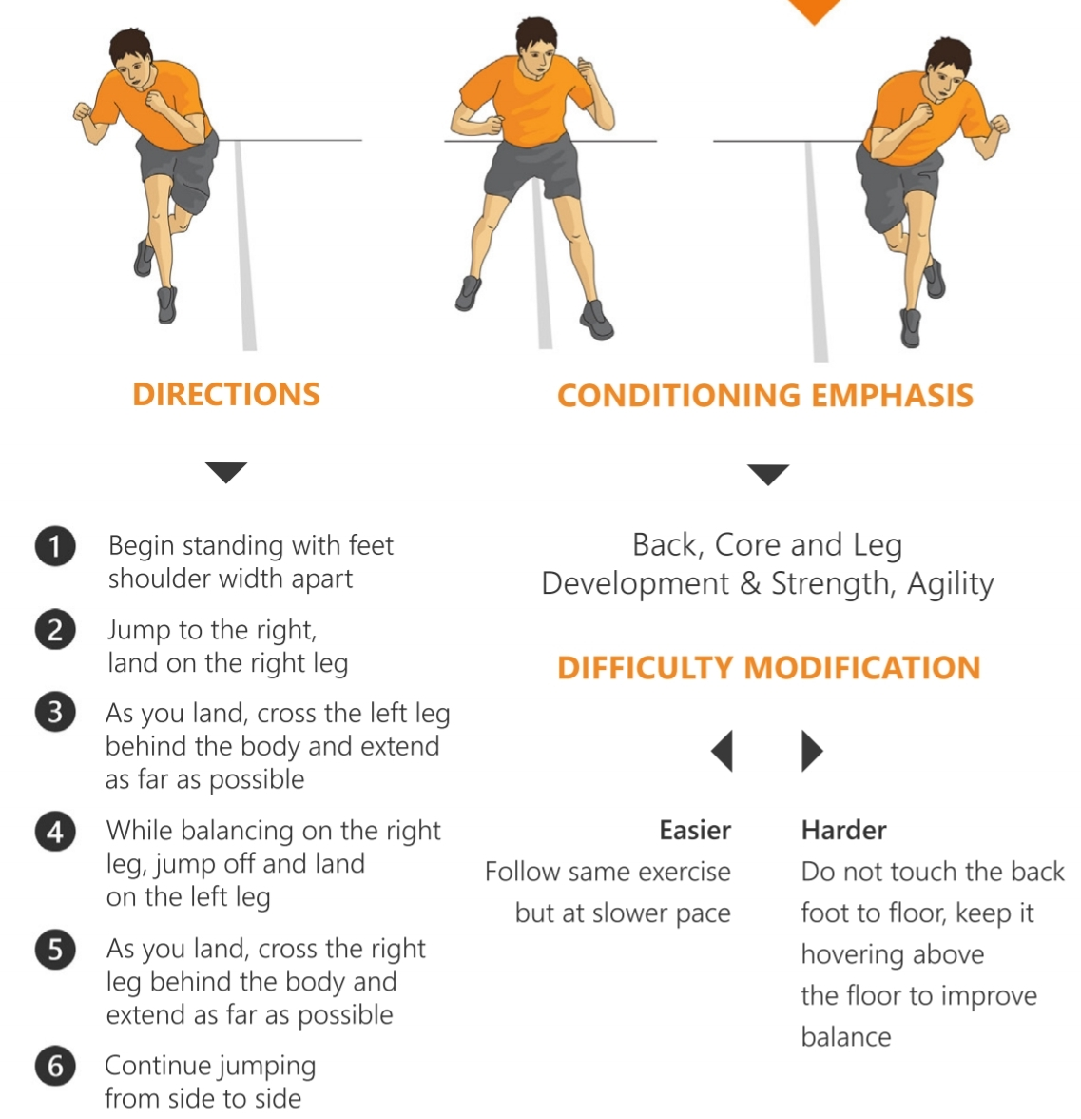
Speed Skater

Slide 51
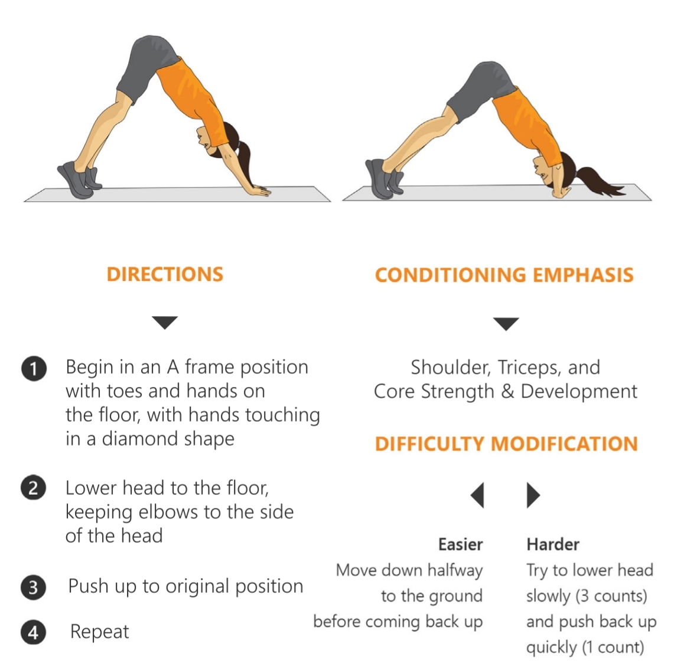
Pike Push-ups

Slide 52
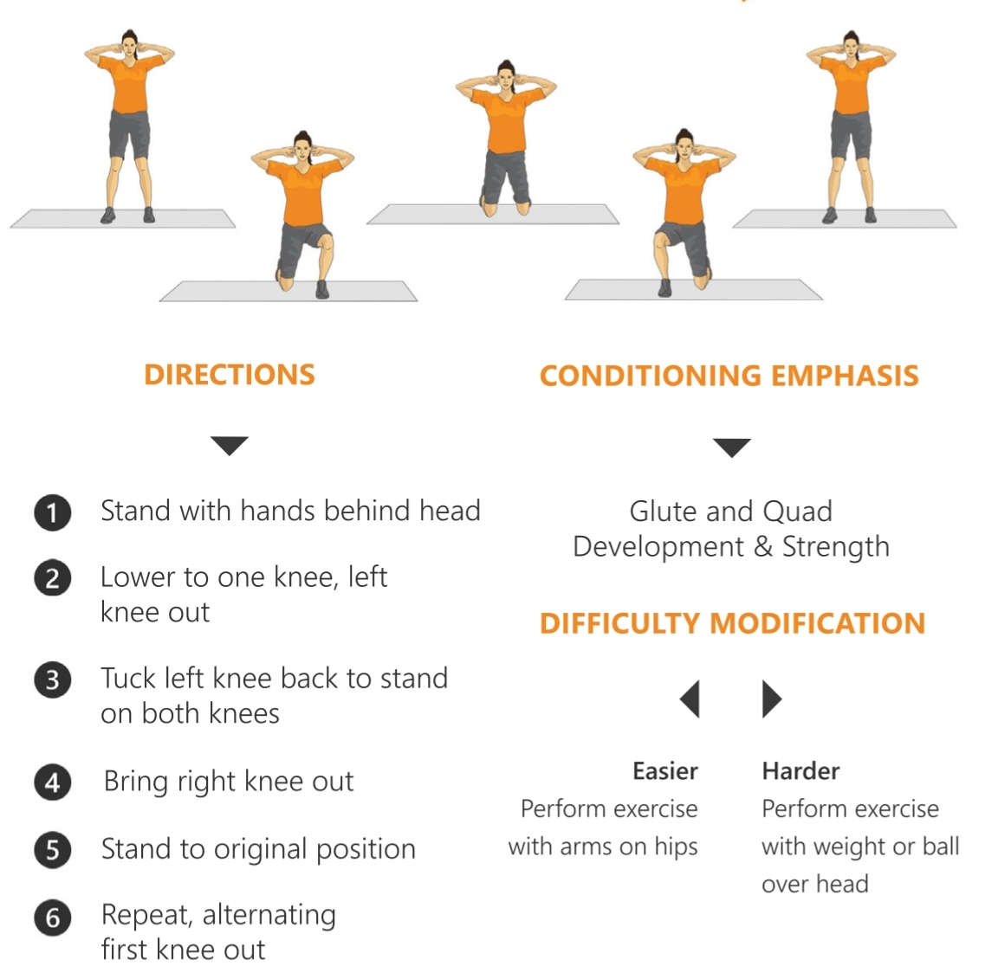
Surrenders

Slide 53
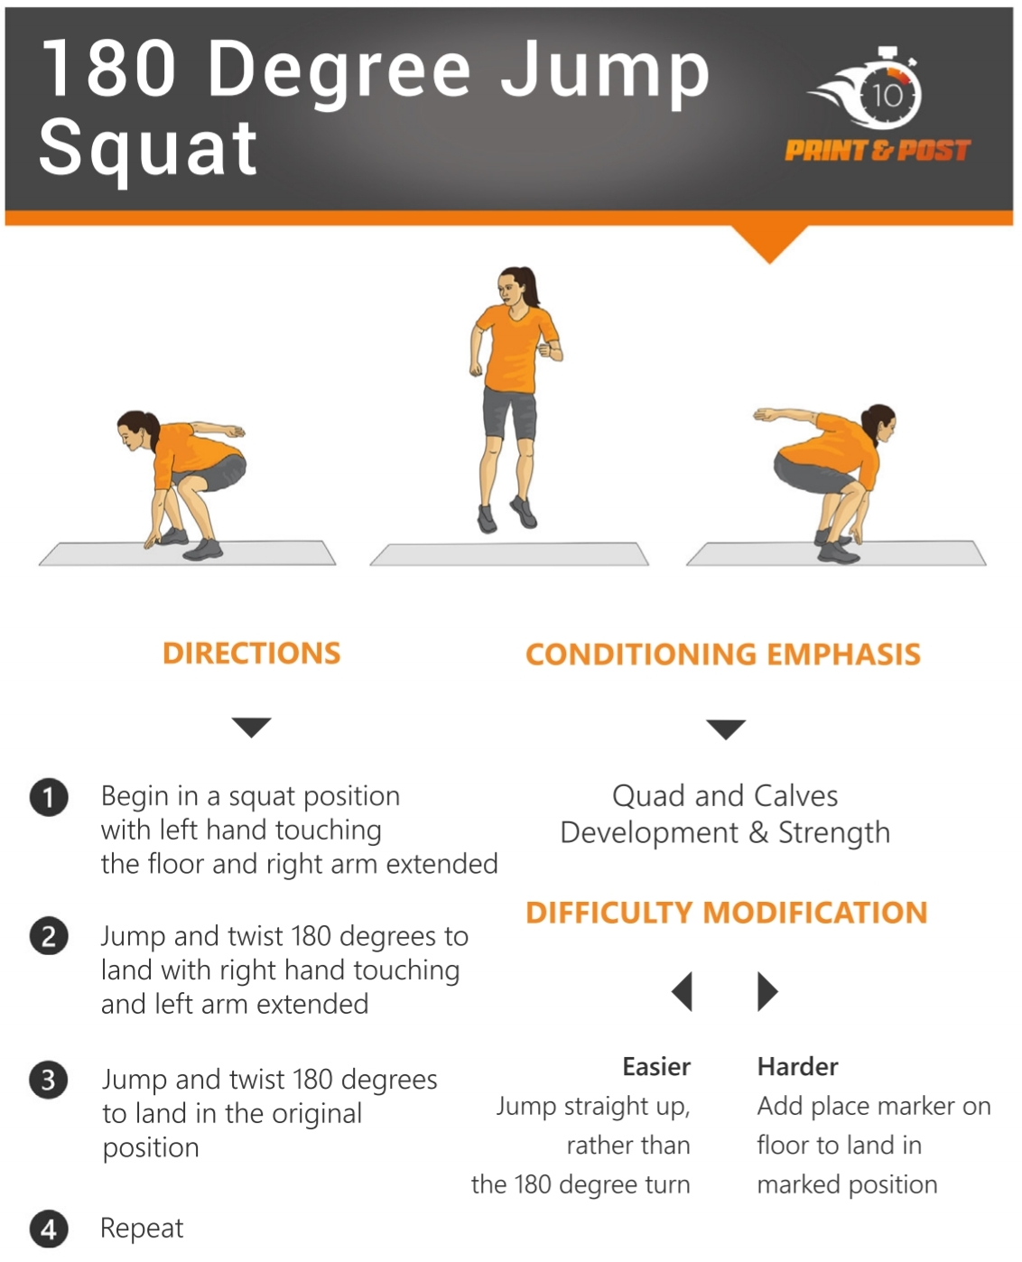
180 Degree Jump Squat

Slide 54
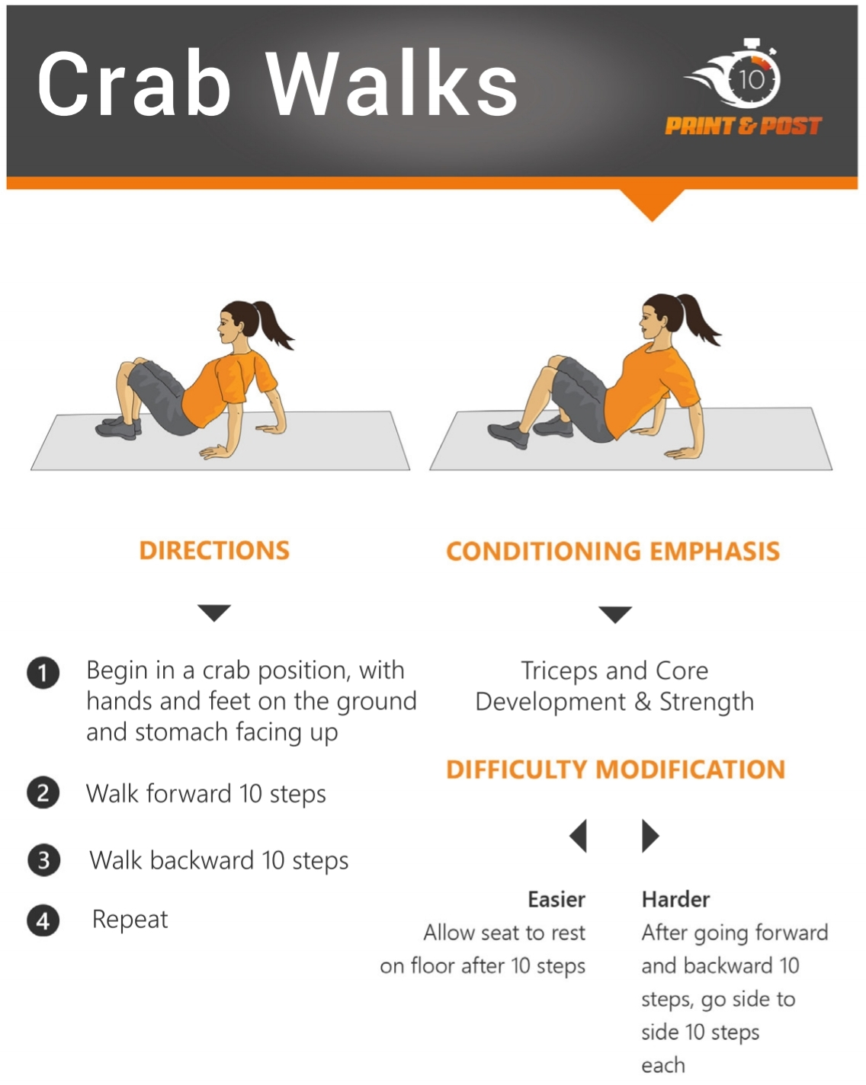
Crab Walks

Slide 55
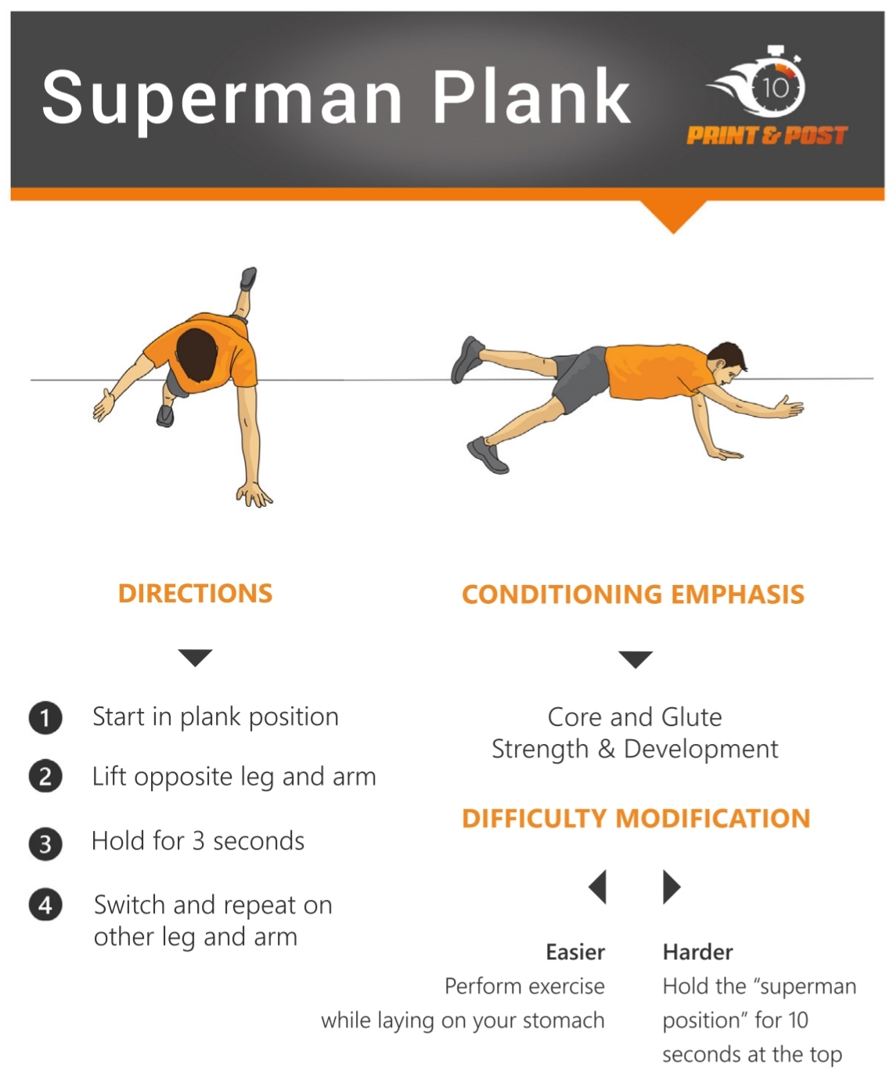
Superman Plank

Slide 56
Personal Best Chart
Name: ________________________________
Exercise | Example | Attempt 1 | Attempt 2 | Attempt 3
Burpees | 16
Walk Outs | 15
Sumo Squat with Side Bend | 12
Up-Down Planks | 25
Speed Skaters | 90
Pike Push-Ups | 7
Surrenders | 15
180 Degree Jump Squat | 8
Crab Walks
Superman Plank

Slide 57
End of Lesson

Slide 58

Date: Thursday 4th March 2021
LO: To understand the term, ‘Harm no living thing’
Subject: Religious Education

Slide 59
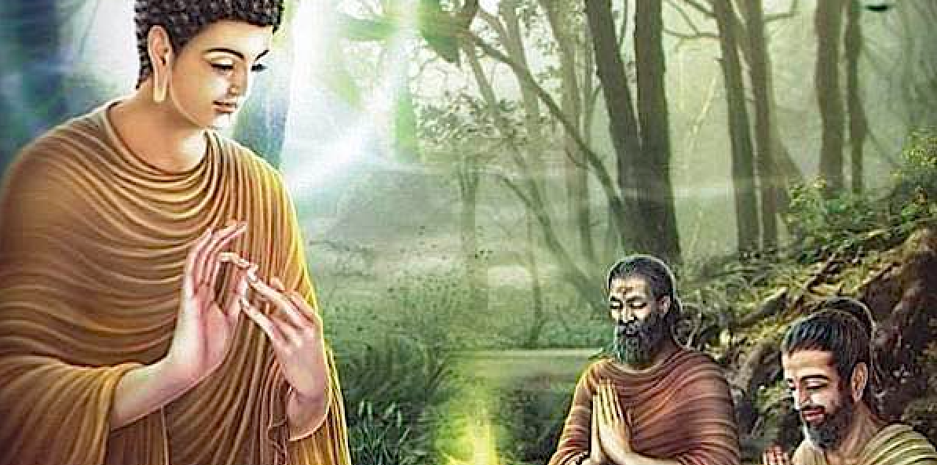
Buddhism
The first precept in Buddhism is;
“Do no harm to any living creature”.

Slide 60

Buddhists should abstain from taking life, and this includes any form of life. This is linked to the idea of rebirth that can include the possibility of being reborn as an animal. Rather than taking life, Buddhists are encouraged to show compassion to all creatures and believe that all life-forms are special, not just human beings.

Slide 61

This first Precept relates to the concept of ahimsa. This is based on the idea of "do no harm".
A Buddhist may argue that destroying the natural habitats of animals is taking away something that does not belong to us. Therefore, by not acting thoughtlessly, Buddhists can protect the environment from destruction and exploitation.

Slide 62

Karma
Buddhists believe that the actions they perform will be beneficial not just to themselves but to the whole world, including the environment. They believe that our actions affect the planet in a harmful way because we are selfish and we crave things. These actions will only result in more suffering in the future, so by being compassionate, we will improve our own future and that of the environment.

Slide 63

The Buddhist story of Prince Siddhartha and the Swan

Slide 64

The Buddha was a well known religious teacher who lived many years ago in India. His real name was Prince Siddhartha and he grew up in a magnificent palace. He was always kind to animals from an early age.

Slide 65

One sunny day, as a young Prince Siddhartha watched a flock of beautiful wild swans flying past, he saw one fall from the sky.

Slide 66

Siddhartha rushed over to the fallen bird to discover it had been shot as there was an arrow sticking out of it’s body. Siddhartha carefully removed the arrow and bathed the wound, gently stroking the swan.

Slide 67

Suddenly Siddhartha’s cousin, Devadatta, came running over. He was carrying a bow. “ That swan is mine. I shot it and I will kill it.” “No, Devadatta,” replied Siddharta, “I have saved the life of the swan, and will look after it until it can fly again.

Slide 68

As the boys could not agree, they went back to the wise people in the palace. A wise old man spoke, “Siddhartha will take care of the swan, for it is better to save a life than to take it away.”

Slide 69

So Siddhartha nursed the swan back to health, and then when it was ready to fly again, the flock of swans returned and the recovered swan flew away with them. Siddhartha was delighted when the swan flew away, but his cousin, Devadatta, became angry and hate grew in his heart.

Slide 70
What were the different things which Prince Siddhartha did to look after the swan?
How does this relate to how we can care for the environment?

Slide 71
The Buddhist declaration stresses the need for all people to have respect for wildlife and for the environment.
The main threat to the world so far has been that human beings have been indifferent to the effects of their actions on other creatures.

Slide 72


For most Buddhists, the principles are to live simply in order to respect all life forms.
Attitudes
They try to change people's attitudes about what they need, to change how they treat the world and each other.

Slide 73

For most Buddhists, the principles are to live simply in order to respect all life forms.
Conservation
Buddhists believe because the Earth's resources are limited, they must be protected and supported wherever possible. They aims to reduce the amount of resources used and protect endangered species, eg by placing a limit on the amount of fish that can be caught and making areas of natural importance into national parks so that they cannot be exploited.

Slide 74

For most Buddhists, the principles are to live simply in order to respect all life forms.
International action and legislation
They support international treaties across the world, to regulate the use of harmful chemicals, or to reduce the output of greenhouse emissions.

Slide 75

For most Buddhists, the principles are to live simply in order to respect all life forms.
Sustainable development
They have faith in future generations, meaning we should try to prevent long-lasting damage to the environment, conserve resources or replace those we use up.

Slide 76
For most Buddhists, the principles are to live simply in order to respect all life forms.
Recycling
Buddhists always recycle waste products so they can be broken down and turned back into
new products. This reduces the amount of waste going into landfill sites or being incinerated.

Slide 77

Your task: In your own words, briefly list all of the ways in which Buddhists aim to ‘harm no living thing.’

Slide 78
End of Lesson

Slide 79
Date: Friday 5th March 2021
L.O To be able to identify your own feelings
Subject: PSHE

Slide 80

We are looking forward to seeing you all back at school on Monday.
It is normal to have mixed emotions about returning to school after a long break.
Excited
Enthusiastic
You might be feeling….
Happy
Relieved
Sad
Nervous

Slide 81

Look at the ‘Feeling blob tree’ and colour in one blob person which you think might show how you are feeling.
It would be good to talk to someone about about how you are feeling.

Slide 82



We want you to feel happy and relaxed about coming back to
school so you can concentrate on your work.
Spend some time today doing activities that you enjoy.
Play a game
Go for a walk
Read a book

Slide 83



We want you to feel happy and relaxed about coming back to
school so you can concentrate on your work.
Spend some time today doing activities that you enjoy.
Ride your bike or scooter
Watch a film
Make a cake

Slide 84


Have a lovely weekend
See you Monday

