Slide 1


Subject: Maths
Base 1

Slide 2


Date: 8.2.21
L.O: To be able to identify a line of symmetry.
Subject: Maths

Slide 3

Pre-recorded Teaching
Access the online teaching video below that will support you to complete the work in this lesson. This video will act as a support but all of the work can still be successfully understood & completed using paper-based versions of this pack. If you need further support to understand / complete work then please contact school via e-mail or telephone.
Play Video
You can also copy and paste this link if you would prefer:
https://classroom.thenational.academy/lessons/to-complete-a-simple-symmetrical-figure-74wpat

Slide 4





Slide 5
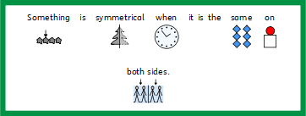
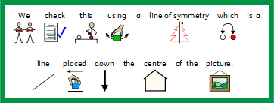


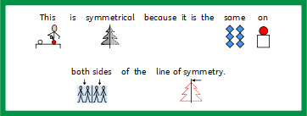

Slide 6
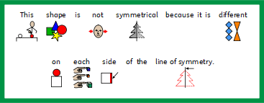

Slide 7

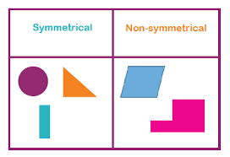
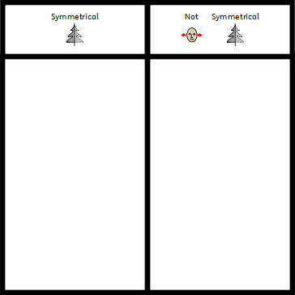

Slide 8




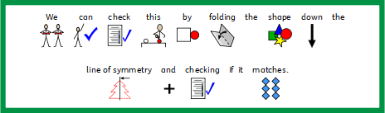

Slide 9
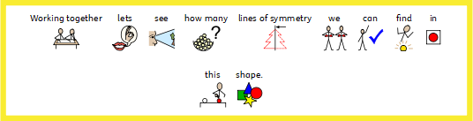




Slide 10



Slide 11
Date: 9.2.21
L.O: To be able to identify lines of symmetry in 2D shapes.
Subject: Maths

Slide 12
Pre-recorded Teaching
Access the online teaching video below that will support you to complete the work in this lesson. This video will act as a support but all of the work can still be successfully understood & completed using paper-based versions of this pack. If you need further support to understand / complete work then please contact school via e-mail or telephone.
Play Video
You can also copy and paste this link if you would prefer:
https://classroom.thenational.academy/lessons/to-identify-lines-of-symmetry-in-2-d-shapes-64tk6e

Slide 13

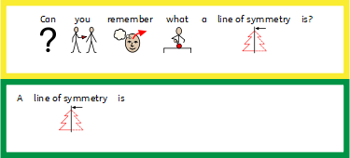

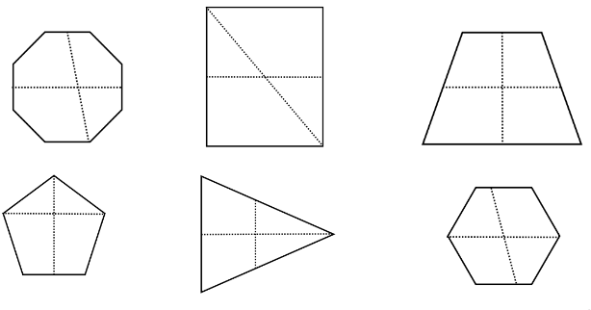

Slide 14

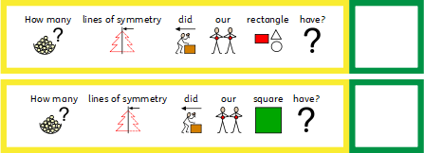



Slide 15
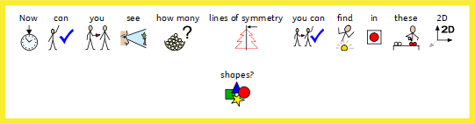



Slide 18
Date: 10.2.21
L.O: To be able to identify symmetry in patterns.
Subject: Maths

Slide 19
Pre-recorded Teaching
Access the online teaching video below that will support you to complete the work in this lesson. This video will act as a support but all of the work can still be successfully understood & completed using paper-based versions of this pack. If you need further support to understand / complete work then please contact school via e-mail or telephone.
Play Video
You can also copy and paste this link if you would prefer:
https://classroom.thenational.academy/lessons/to-identify-lines-of-symmetry-in-a-pattern-cgrkcc

Slide 20




Slide 21

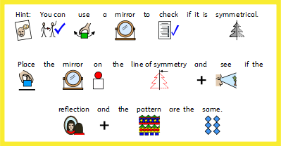



Slide 22


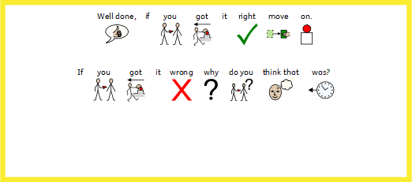

Slide 23


Slide 25
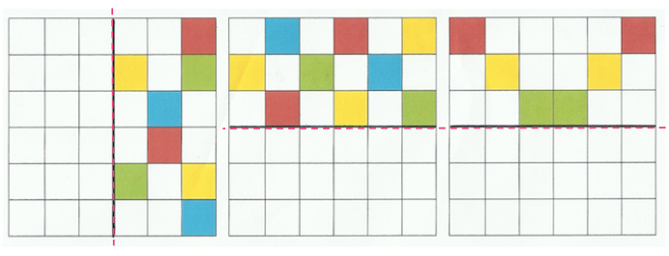

Slide 26
Date: 11.2.21
L.O: To be able to complete symmetry based problems.
Subject: Maths

Slide 27
Pre-recorded Teaching
Access the online teaching video below that will support you to complete the work in this lesson. This video will act as a support but all of the work can still be successfully understood & completed using paper-based versions of this pack. If you need further support to understand / complete work then please contact school via e-mail or telephone.
Play Video
You can also copy and paste this link if you would prefer:
https://classroom.thenational.academy/lessons/to-investigate-a-problem-using-symmetry-part-1-6cw66t

Slide 28

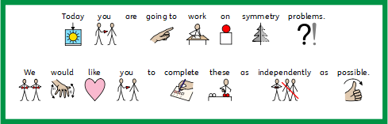

Slide 29
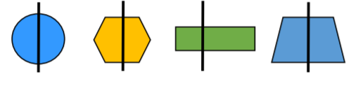
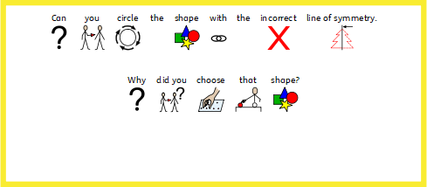

Slide 30

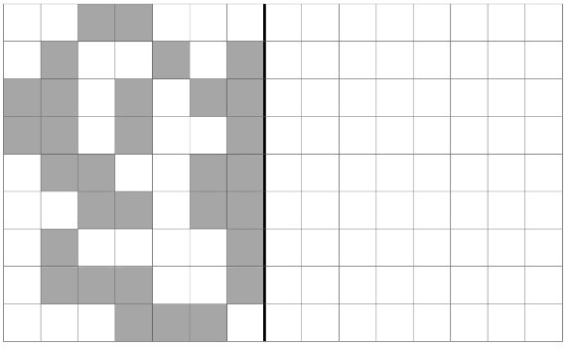

Slide 31

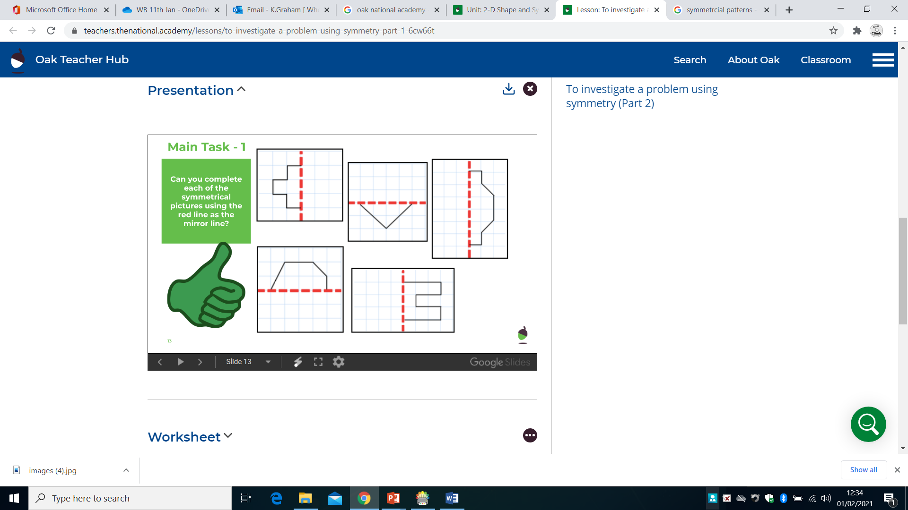

Slide 32
Date: 12.2.21
L.O: To be able to mentally complete addition and subtraction sums.
Subject: Maths intervention.

Slide 33
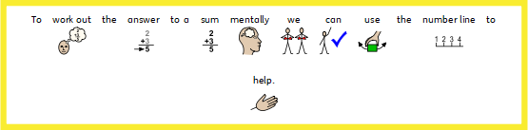


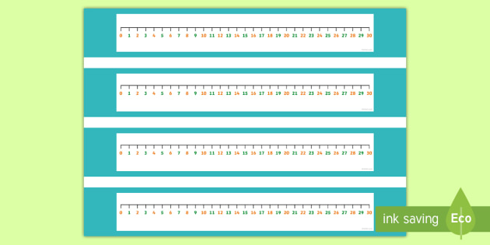



Slide 34
