Slide 1

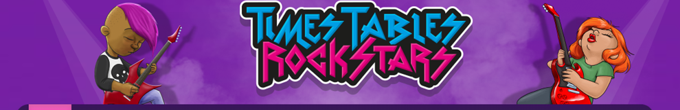


25.01.2021
LO To be able to add and subtract 10s mentally
Go to Times Tables Rock Stars to warm up your number brain before you start your maths activity.
Subject: Maths

Slide 2
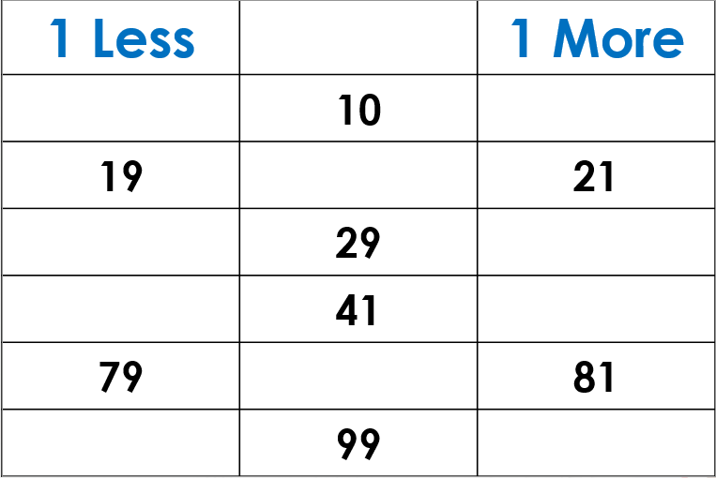
Fill in the missing numbers
10
10

Slide 3
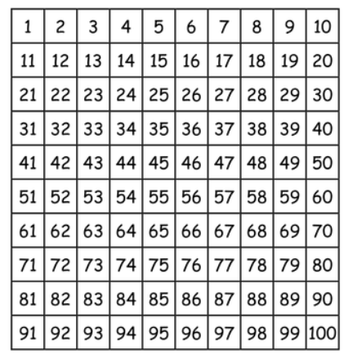
Adding 10
Use the number square to help you mentally solve the calculations
Fifty seven add ten
Forty four subtract ten
Eighty three subtract two tens
Seventy three add 3 tens

Slide 4
How did you do?
Use the number square to help you mentally solve the calculations
Fifty seven add ten is sixty seven
Forty four subtract ten thirty four
Eighty three subtract two tens sixty three
twenty three add 3 tens fifty three

Slide 5
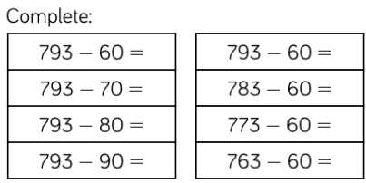
Complete the number sentences
Four thousand three hundred and forty five add ten
Three thousand seven hundred and twenty six add three tens
Nine thousand two hundred and thirty four subtract two tens
Six thousand five hundred and eighty three subtract four tens
Seven thousand nine hundred and thirty six add five tens
Eight thousand three hundred and forty two add five tens

Slide 6
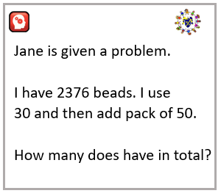
Try this challenge

Slide 7
26.01.2021
LO To be able to add and subtract 100s mentally.
Go to Times Tables Rock Stars to warm up your number brain before you start your maths activity.
Subject: Maths

Slide 8
Fill in the missing numbers
100
100
2654
6785
8274
9250
4654

Slide 9
Find the missing number
4158 +__________= 4358
5258+__________=5658
6365+___________=6765
1965- __________=1265
2745- __________ = 2545
4852- __________=4352

Slide 10
How did you do?
4158 + 200= 4358
5258 + 400=5658
6365 + 400=6765
1965 - 700=1265
2745 - 200= 2545
4852 - 500=4352

Slide 11
Complete the bar models
3845
3245
4545
4145
625 | 7300
245 | 4500

Slide 12
Complete the number sentences
Six thousand five hundred and eighty four add three hundred is
Two thousand four hundred and twenty two add five hundred is
Seven thousand two hundred and eleven add six hundred is
Six thousand nine hundred and fifty six subtract four hundred is
Three thousand eight hundred and thirty five subtract four hundred is
Five thousand seven hundred and seventy seven subtract six hundred is

Slide 13
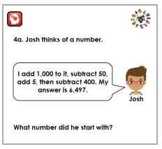
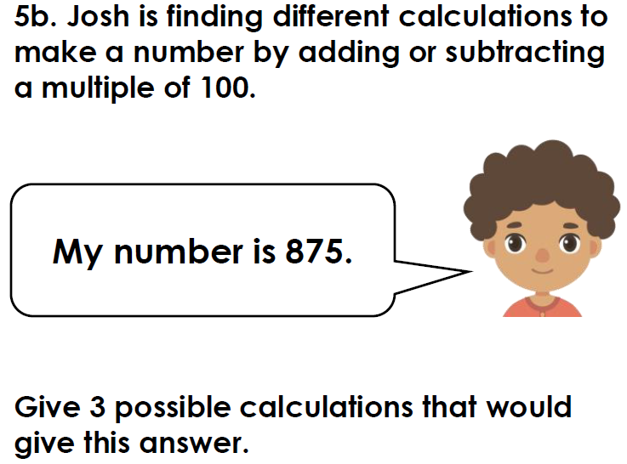
Try this challenge

Slide 14
27.01.2021
LO To be able to add and subtract 1000s mentally.
Go to Times Tables Rock Stars to warm up your number brain before you start your maths activity.
Subject: Maths

Slide 15
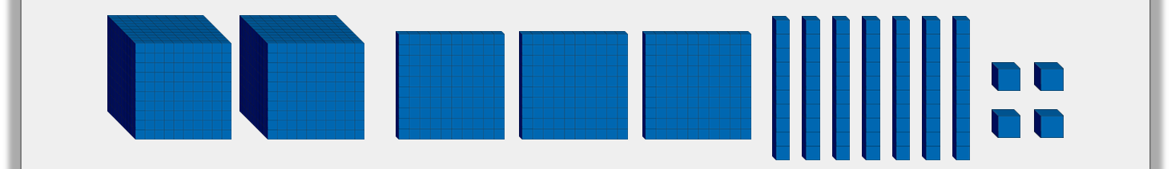
Starting with the number below, complete the calculations.
Add 3,000
Subtract 50
Add 200
What is the final answer?

Slide 16
How did you do?
Add 3,000
Subtract 50
Add 200
The final answer is 5524

Slide 17
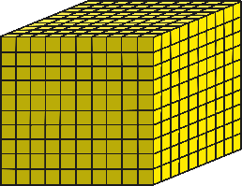
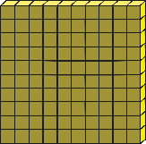
What number is being represented here?
Number:
Number in words:
Subtract 2 thousands from the number.
Subtract 1 hundred from the number.
Subtract 5 tens from the number.
Subtract 8 ones from the number.

Slide 18
How did you do?
5365
Number:
Number in words:
Subtract 2 thousands from the number.
Subtract 1 hundred from the number.
Subtract 5 tens from the number.
Subtract 8 ones from the number.
five thousand, three hundred and sixty-five
3365
5265
5315
5357

Slide 19

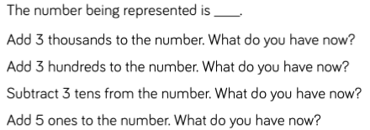
Complete the number sentences
Six thousand four hundred and eleven add three thousand is
Seven thousand three hundred and twenty four add two thousand three hundred is
Three thousand two hundred and twenty seven subtract one thousand and three tens is
Two thousand nine hundred and fifty five subtract one thousand four hundreds and six ones is

Slide 20
Try this challenge

Slide 21
27.01.2021
LO To be able to solve problems.
Go to Times Tables Rock Stars to warm up your number brain before you start your maths activity.
Subject: Maths

Slide 22
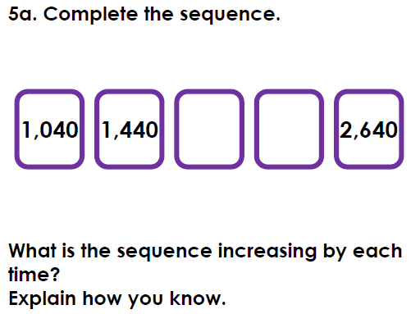
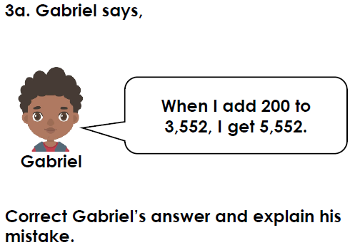
Solve the word problems

Slide 23
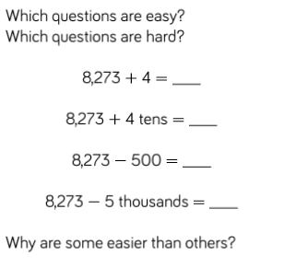
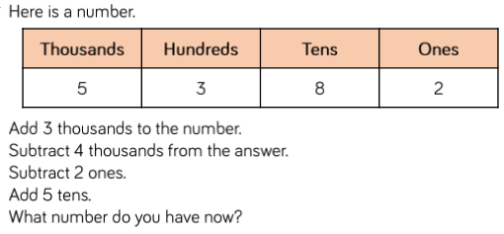
Solve the problems

Slide 24
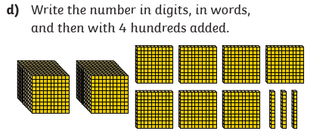
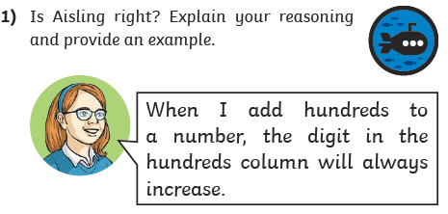
Solve the problems

Slide 25
29.01.2021
LO To be able to practise the 6 times table
Go to Times Tables Rock Stars to warm up your number brain before you start your maths activity.
Subject: Maths

Slide 26
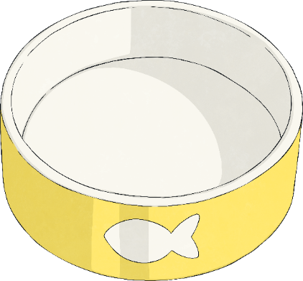

Complete the sentences about the picture below
There were treats altogether.
They were shared between bowls.
Now there are treats in each bowl.
÷ = .
or ÷ = .
There are lots of treats.
There are treats in total.
× = .
or × = .
6
24

Slide 27
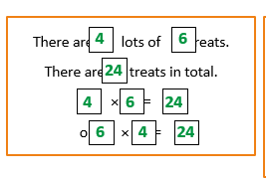
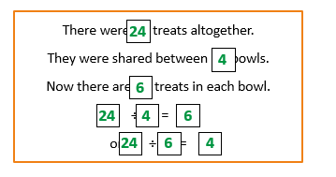
How did you do?

Slide 28
Fill in the missing numbers
0 6 12 _____ _____ 30 _____ _____ 48 _____ 60 _____ _____
72 _____ 60 _____ _____ 42 _____30 _____ _____ _____ _____ _____
36 _____ _____ 54 _____ _____ _____
54 _____ _____36 _____ _____ _____ _____ _____ _____
Click on this link to help you https://teachers.thenational.academy/lessons/use-known-multiplication-facts-to-derive-our-6-times-table-6cup4e?from_query=6+time

Slide 29
Colour in the squares that are multiples of 6

Slide 30
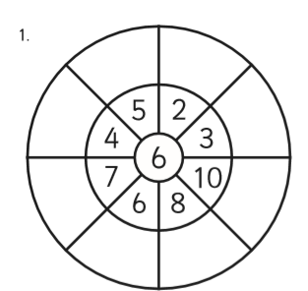
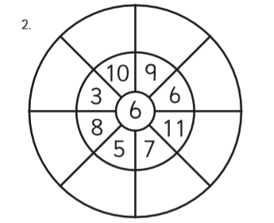
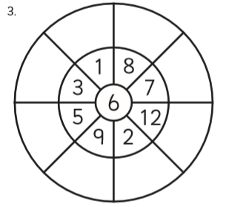
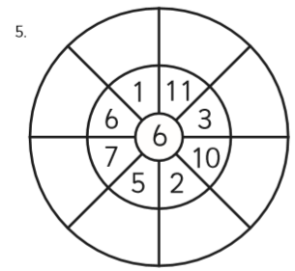
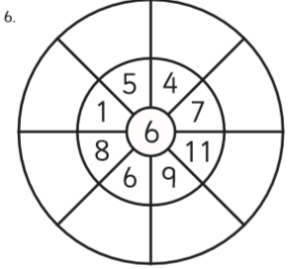
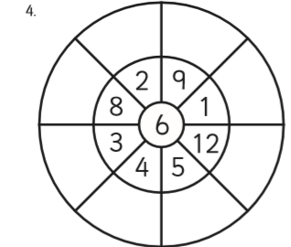
Complete the multiplication wheels
6x2=12
12

