Slide 1



Date: Tuesday 19th January 2021
LO: To be able to write the introduction for a non-chronological report.
Subject: English

Slide 2
Read, copy, cover, spell today’s spellings.
yacht
vehicle
system
lightning
language
restaurant
physical
stomach
recognise
pronunciation

Slide 3
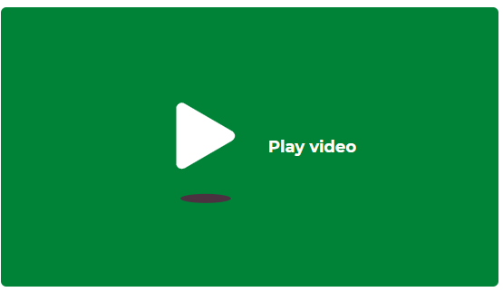
You will need: A pen or pencil (unless using a computer). Something to write on or type on. | You can complete this task by: Writing tasks on a piece of paper and email in a picture of your work. Writing tasks in a Word document and email a copy of your work. Writing tasks on a piece of paper and using the Friday drop box.
Email completed work to trailblazerspupils@gmail.com or use the drop box on Friday.
Click me
https://classroom.thenational.academy/lessons/to-write-the-opening-of-a-non-chronological-report-68u3ce?step=1&activity=video

Slide 4
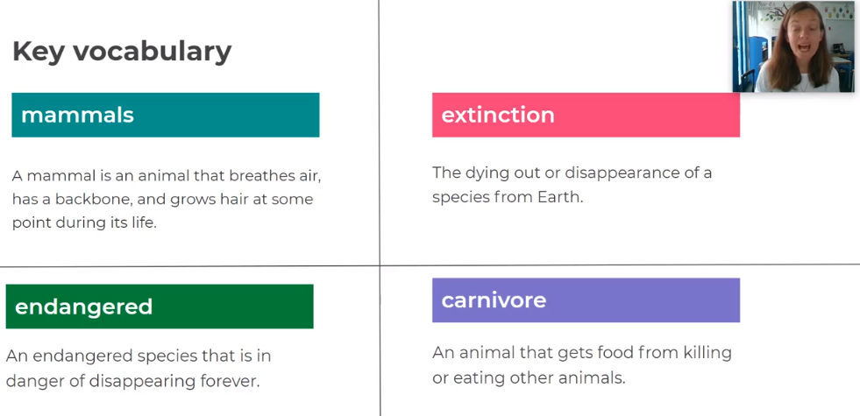

Slide 5
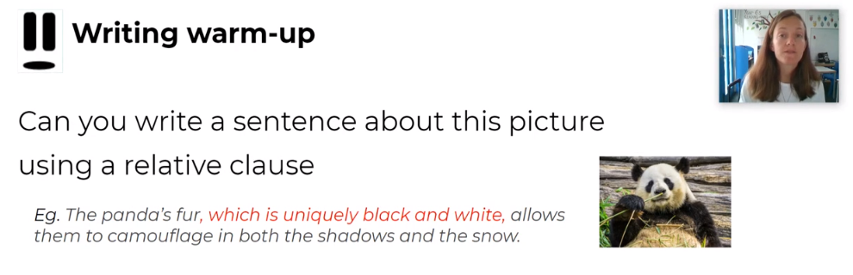

Slide 6
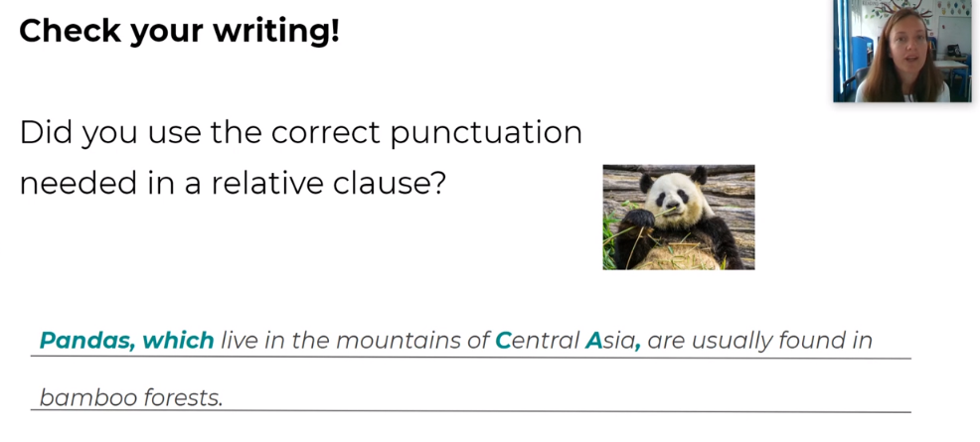
Why have I used capital letters for Central Asia?

Slide 7
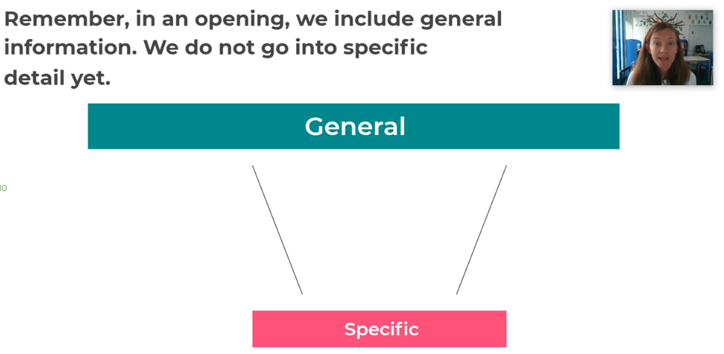

Slide 8
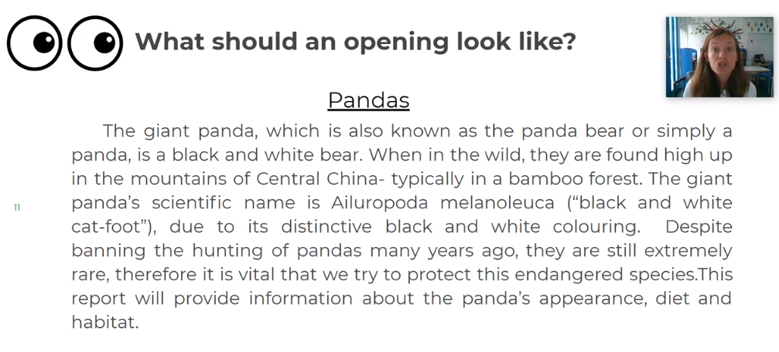

Slide 9
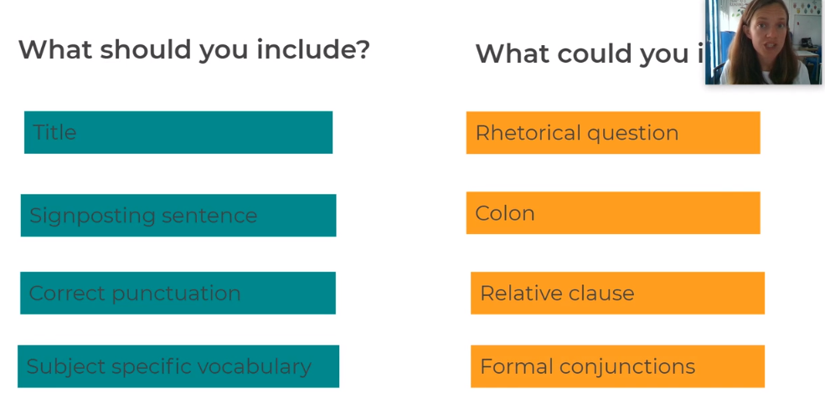

Slide 10
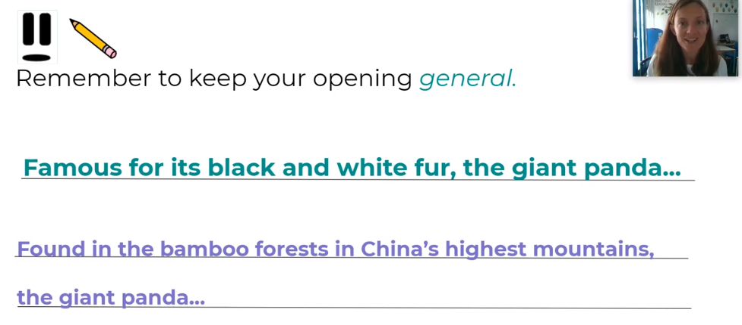
Here are some sentence openers that you could use.

Slide 11
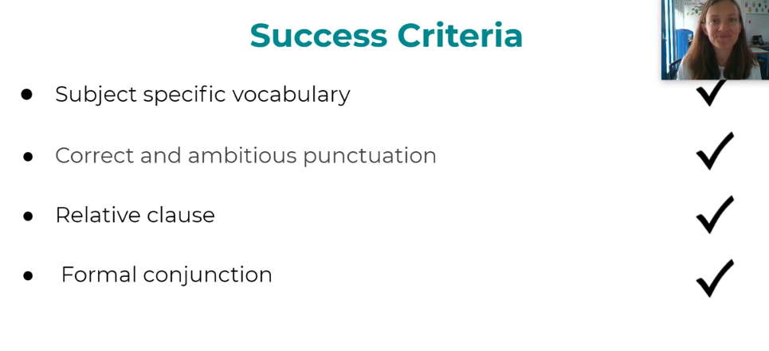

Slide 12
Task
Write the introduction to your non-chronological report, using the notes and lessons from last we.

Slide 13

Reading time
Now that you have finished your main task, please enjoy some reading time.
You can read to yourself, an adult or sibling.
This can be done by logging on to your myON account, picking a book or magazine and enjoying at least 15 minutes reading time.
https://www.myon.co.uk/login/index.html
Remember that your login is your first name and first letter of your surname then password:
harryp
password1
Please email trailblazerspupils@gmail.com if you have any login issues.

Slide 14
End of lesson

Slide 15
Date: Wednesday 20th January 2021
LO: To be able to plan a paragraph on appearance.
Subject: English

Slide 16
Read, copy, cover, spell today’s spellings.
yacht
vehicle
system
lightning
language
restaurant
physical
stomach
recognise
pronunciation

Slide 17
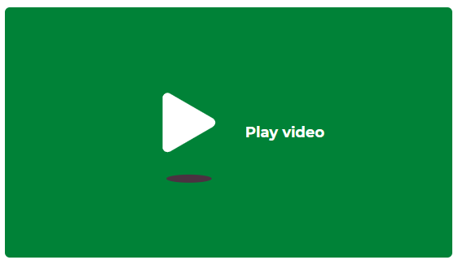
You will need: A pen or pencil (unless using a computer). Something to write on or type on. | You can complete this task by: Writing tasks on a piece of paper and email in a picture of your work. Writing tasks in a Word document and email a copy of your work. Writing tasks on a piece of paper and using the Friday drop box.
Email completed work to trailblazerspupils@gmail.com or use the drop box on Friday.
Click me
https://classroom.thenational.academy/lessons/to-plan-the-paragraph-on-appearance-64wp4t?activity=video&step=1

Slide 18
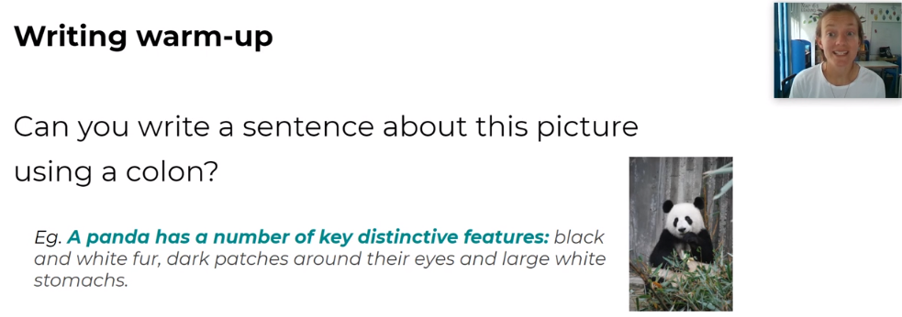

Slide 19
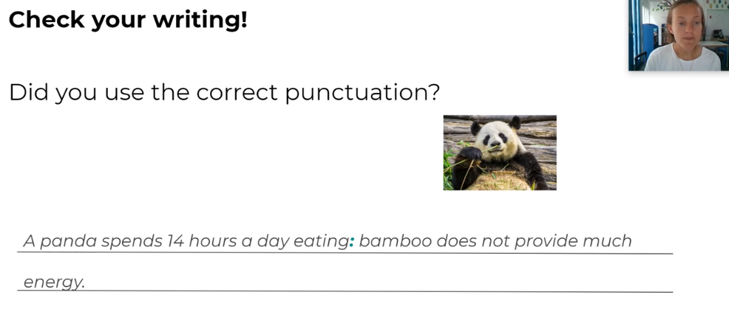

Slide 20
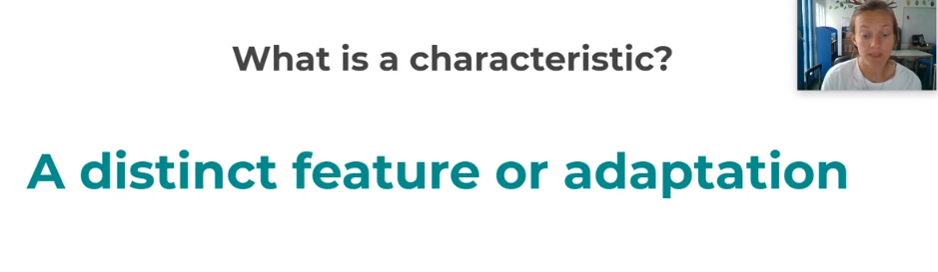

Slide 21
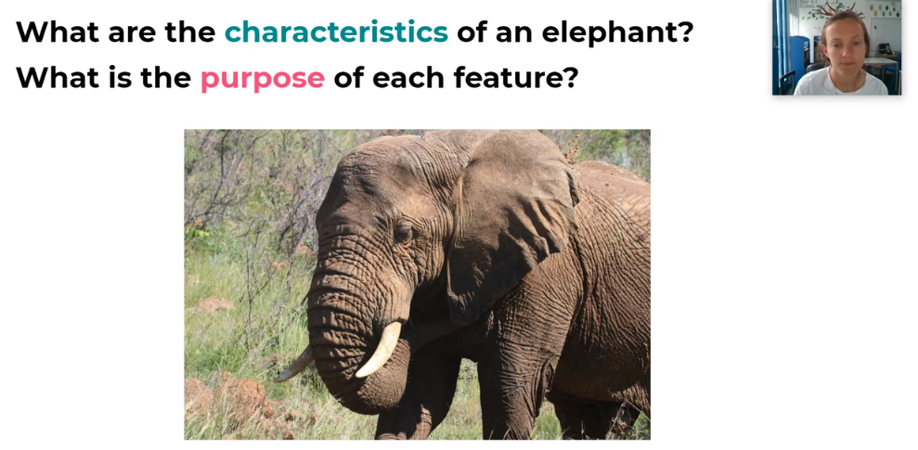

Slide 22
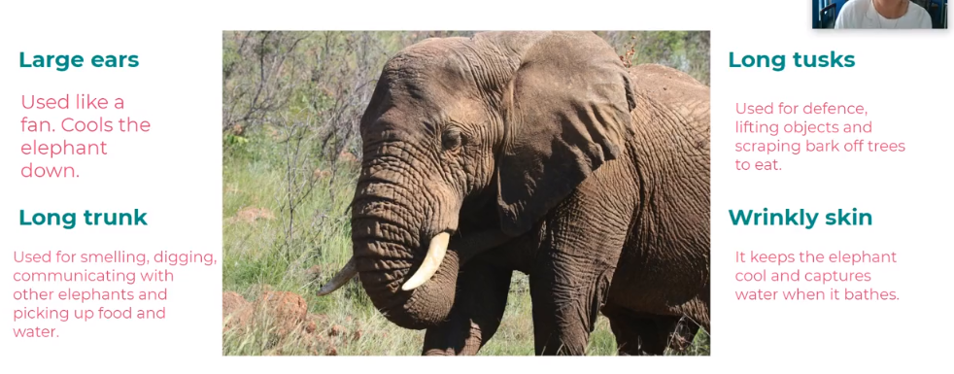

Slide 23
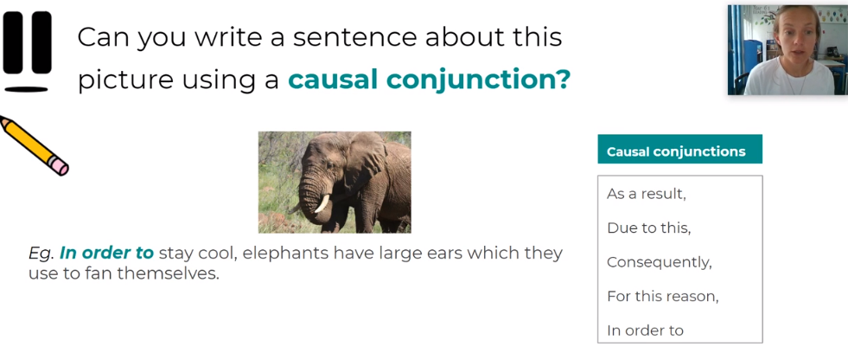

Slide 24
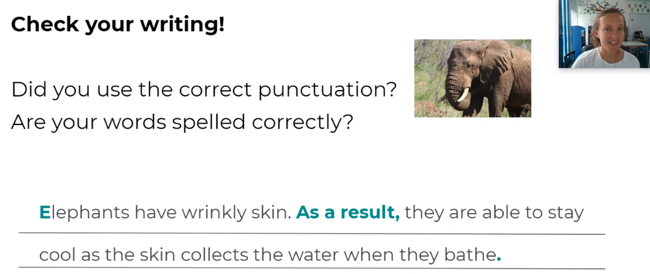

Slide 25
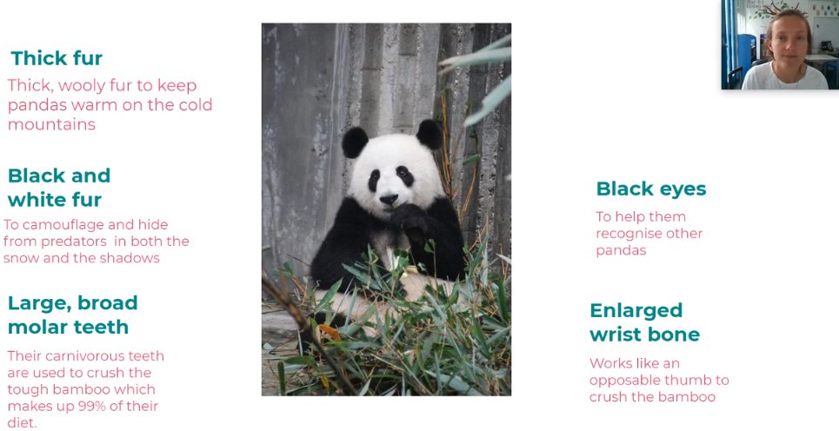

Slide 26
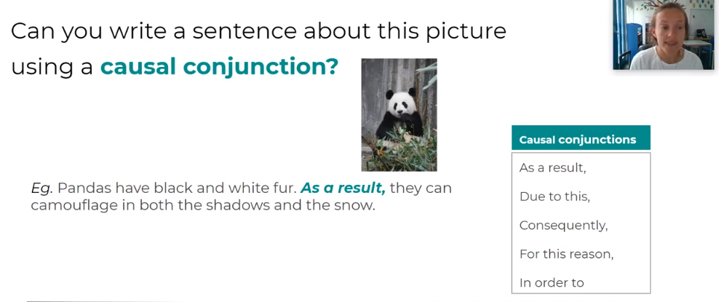

Slide 27
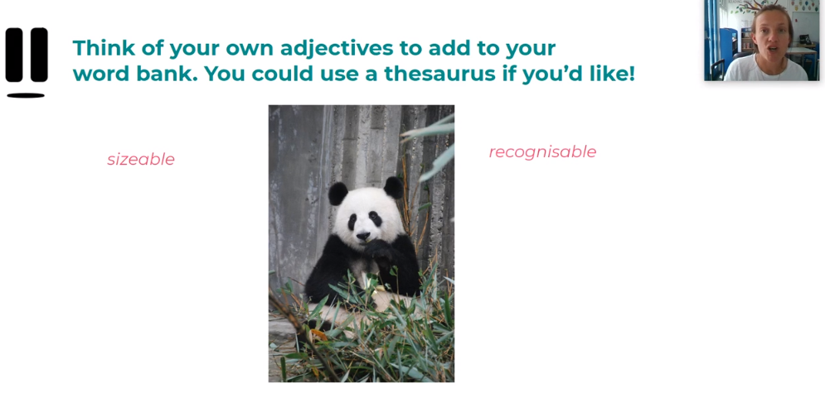

Slide 28
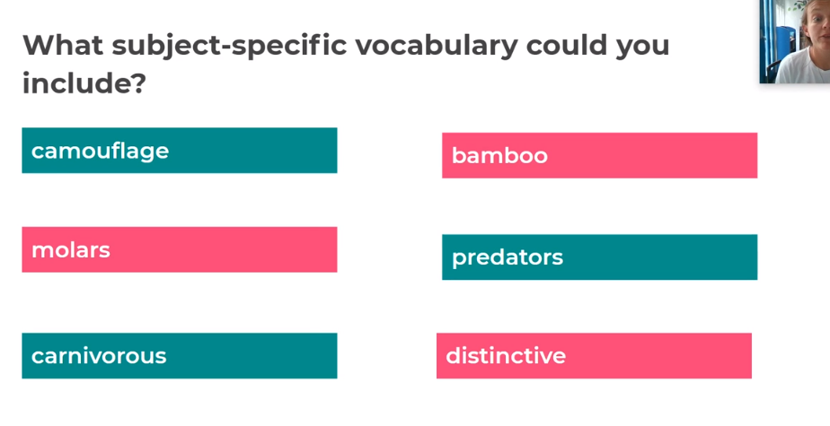

Slide 29
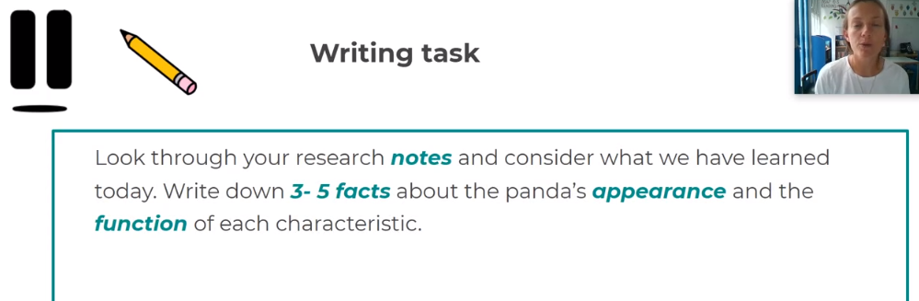

Slide 30
The notes that you have made today MUST be kept to help you with the rest of your non-chronological report lessons.
See you tomorrow.

Slide 31
Reading time
Now that you have finished your main task, please enjoy some reading time.
You can read to yourself, an adult or sibling.
This can be done by logging on to your myON account, picking a book or magazine and enjoying at least 15 minutes reading time.
https://www.myon.co.uk/login/index.html
Remember that your login is your first name and first letter of your surname then password:
harryp
password1
Please email trailblazerspupils@gmail.com if you have any login issues.

Slide 32
End of lesson

Slide 33
Date: Thursday 21st January 2021
LO: To be able to write a paragraph about appearance.
Subject: English

Slide 34
Read, copy, cover, spell today’s spellings.
yacht
vehicle
system
lightning
language
restaurant
physical
stomach
recognise
pronunciation

Slide 35
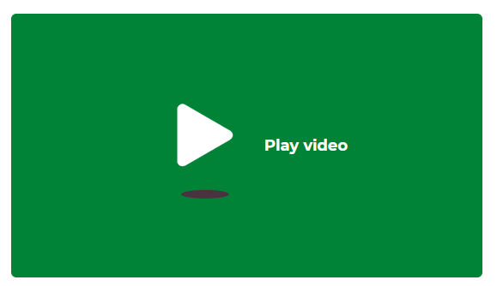
You will need: A pen or pencil (unless using a computer). Something to write on or type on. | You can complete this task by: Writing tasks on a piece of paper and email in a picture of your work. Writing tasks in a Word document and email a copy of your work. Writing tasks on a piece of paper and using the Friday drop box.
Email completed work to trailblazerspupils@gmail.com or use the drop box on Friday.
Click me
https://classroom.thenational.academy/lessons/to-write-the-paragraph-on-appearance-68wk2e?activity=video&step=1

Slide 36
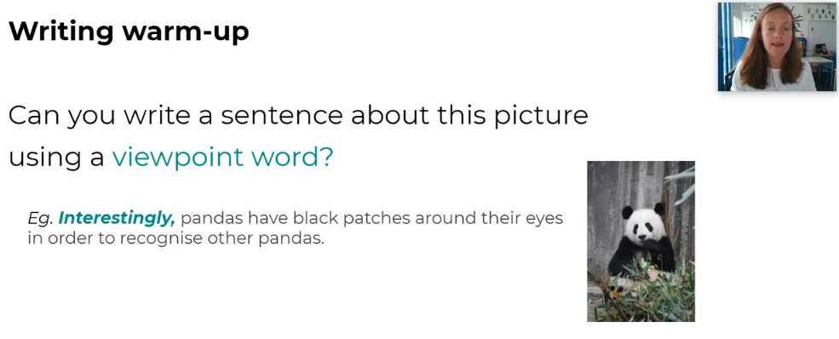
Viewpoint word
In class, you will have used lots of them but we call them adverb openers.

Slide 37
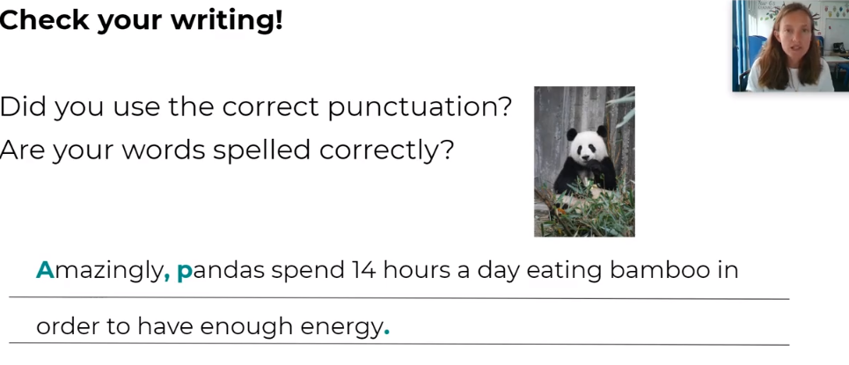

Slide 38
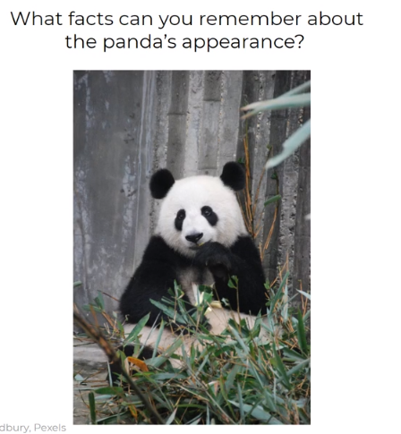

Slide 39
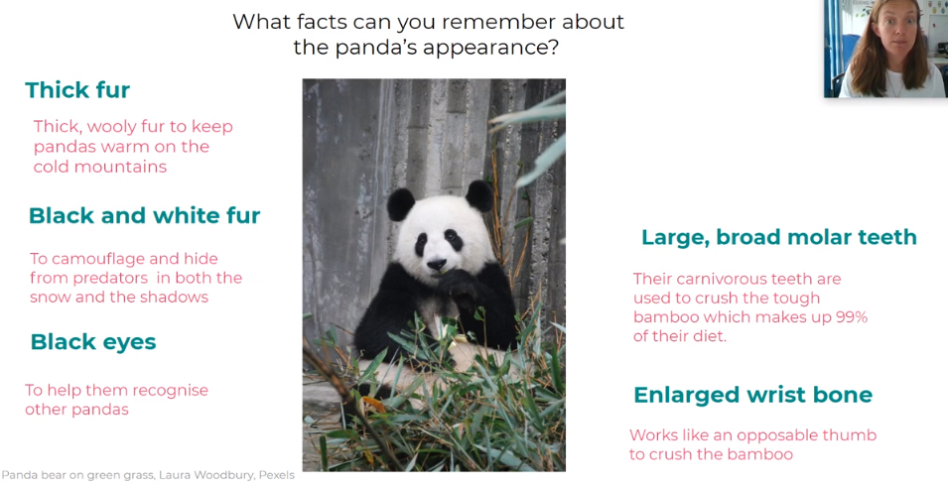

Slide 40
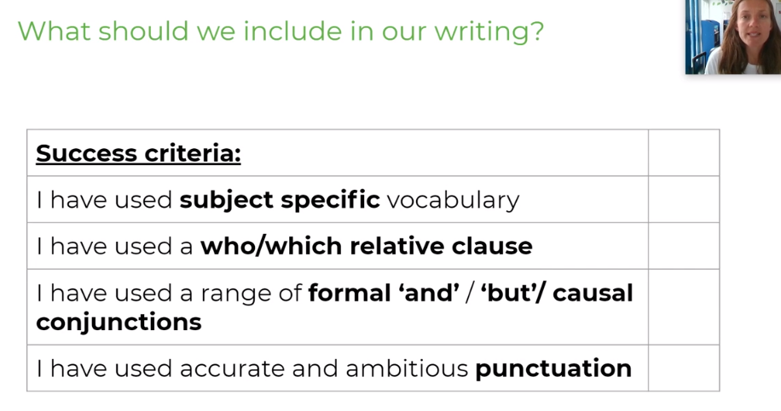

Slide 41
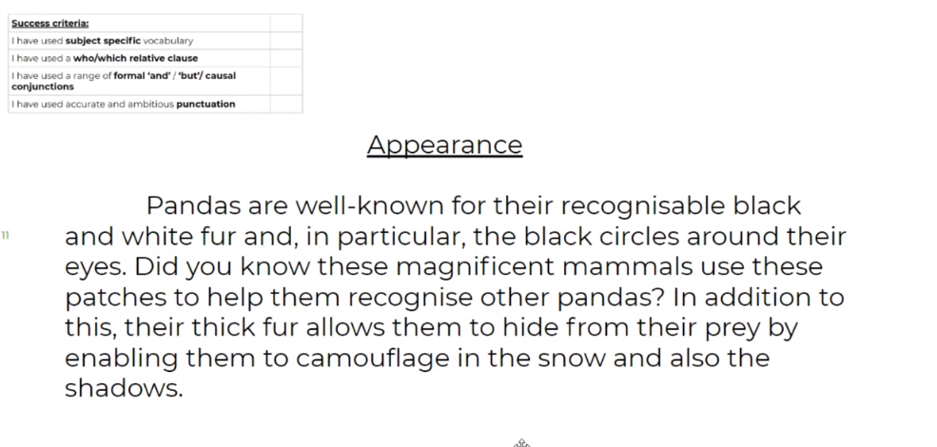
Example

Slide 42
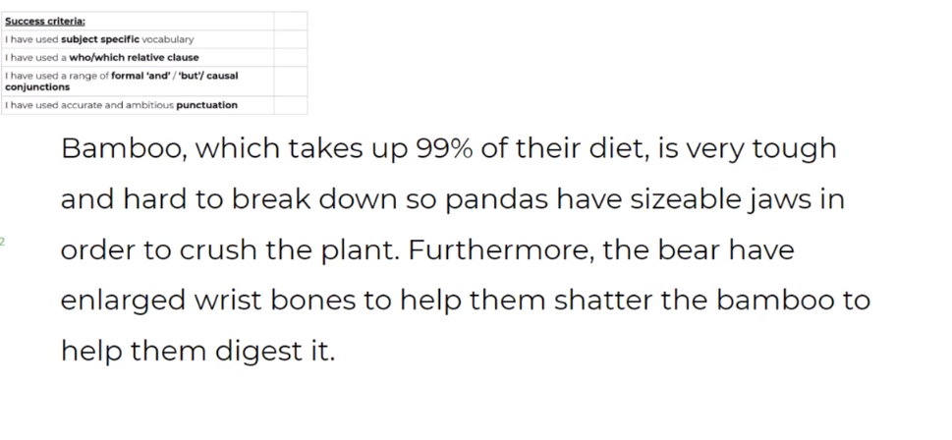
Example

Slide 43
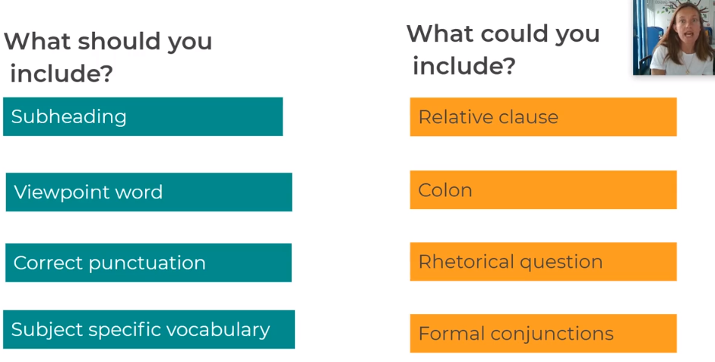
Independent writing

Slide 44
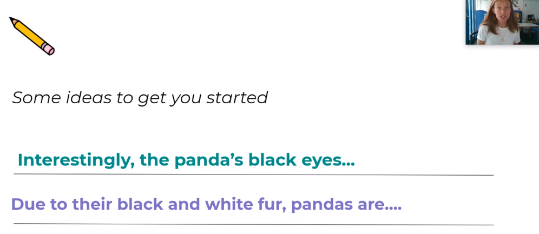

Slide 45
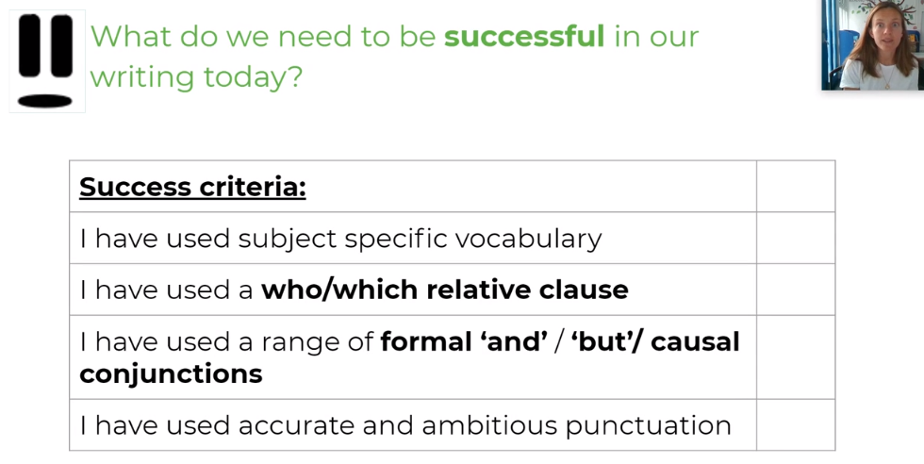

Slide 46
Task
Write two paragraphs about appearance for your non-chronological report, using the notes and lessons over the past two weeks

Slide 47
Reading time
Now that you have finished your main task, please enjoy some reading time.
You can read to yourself, an adult or sibling.
This can be done by logging on to your myON account, picking a book or magazine and enjoying at least 15 minutes reading time.
https://www.myon.co.uk/login/index.html
Remember that your login is your first name and first letter of your surname then password:
harryp
password1
Please email trailblazerspupils@gmail.com if you have any login issues.

Slide 48
End of lesson

Slide 49
Date: Friday 22nd January 2021
LO: To be able to use apostrophe for plural possession.
Subject: English

Slide 50
Read, copy, cover, spell today’s spellings.
yacht
vehicle
system
lightning
language
restaurant
physical
stomach
recognise
pronunciation

Slide 51
Recap
Punctuate the following sentences:
The cats tail is black.
Liams eyes are blue.
That girls car is red.
The park is next to Karens house.

Slide 52
Recap
Punctuate the following sentences:
The cat's tail is black.
Liam's eyes are blue.
That girl's car is red.
The park is next to Karen's house.

Slide 53
’
What is an apostrophe?
It is a punctuation mark used to show possession.
What does possession mean?
Something that belongs to someone or something. E.g., Tree’s branches, Emily’s hand.
What is plural possession?
This means something that belongs to many things. E.g., Men’s shoes, Boys’ ball.

Slide 54
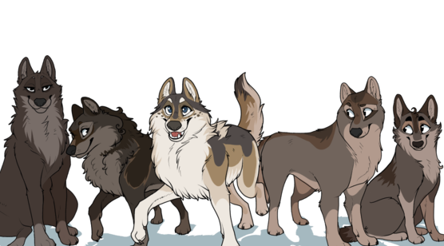
When we are talking about more than one thing, we call this plural.
The plural of man is men
wolf is wolves
country is countries
child is children

Slide 55
Write down the plural form for these nouns.
Woman | Cat | Boy | Car
Dog | Box | Apple | Leaf

Slide 56
Write down the plural form for these nouns
Check your answers.
Women | Cats | Boys | Cars
Dogs | Boxes | Apples | Leaves

Slide 57

If we want to show plural possession and the plural form of the noun ends in ‘s’, we put the apostrophe after the s.
The alarms' ringing woke me up.

Slide 58
If we want to show plural possession and the plural form of the noun ends in ‘s’, we put the apostrophe after the s.
The books’ covers are red.

Slide 59
If we want to show plural possession and the plural form of the noun ends in ‘s’, we put the apostrophe after the s.
The bees’ nest.

Slide 60
If we want to show plural possession and the plural form of the noun doesn’t end in ‘s’, add an apostrophe and then s.
Children’s toys

Slide 61
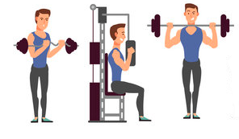
If we want to show plural possession and the plural form of the noun doesn’t end in ‘s’, add an apostrophe and then s.
Men’s muscles

Slide 62
Can you write the plural possession?
bees
bodies

Slide 63
Can you write the plural possession?
bees’
bodies
Because the word is plural and ends in ‘s’ we add an apostrophe after the ‘s’

Slide 64
Can you write the plural possession?
petals
colour

Slide 65
Can you write the plural possession?
petals’
colour
Because the word is plural and ends in ‘s’ we add an apostrophe after the ‘s’

Slide 66
Can you write the plural possession?
people
eyes

Slide 67
Can you write the plural possession?
people’s
eyes
Because the word is plural and doesn’t ends in ‘s’ we add an apostrophe and then the ‘s’

Slide 68
Look at the nouns you wrote earlier. Can you write the plural possession?
Women | Cats | Boys | Cars
Dogs | Boxes | Apples | Leaves

Slide 69
Look at the plural nouns you wrote earlier. Can you write the plural possession?
Women’s | Cats’ | Boys’ | Cars’
Dogs’ | Boxes’ | Apples’ | Leaves’
Women is the only plural noun that doesn’t end in ‘s’, so we add the apostrophe then the s.

Slide 70
How can we show…
The leaves that belong to the trees
The paws that belong to the dogs
The books that belong to the children
the trees’ leaves
the dogs’ paws
the children’s books

Slide 71

Have a look at the sentences below. Are they punctuated correctly?
The horses neighs’ could be heard from miles away.
The birds’ wings flapped in the wind.
The fairies' wings were iridescent.
Fish got caught in the mens’ nets.

Slide 72
We know that the sentences below are punctuated incorrectly. Write the sentence out using the apostrophe correctly.
The horses neighs’ could be heard from miles away.
Fish got caught in the mens’ nets.

Slide 73
We know that the sentences below are punctuated incorrectly. Write the sentence out using the apostrophe correctly.
The horses’ neighs could be heard from miles away.
Fish got caught in the men’s nets.
The neighs belong to the horses, so the apostrophe goes after the ‘s’ in horses. The plural of man is men, so the apostrophe goes before the s.

Slide 74
Task
Write five sentences using apostrophes for plural possession.

Slide 75
Reading time
Now that you have finished your main task, please enjoy some reading time.
You can read to yourself, an adult or sibling.
This can be done by logging on to your myON account, picking a book or magazine and enjoying at least 15 minutes reading time.
https://www.myon.co.uk/login/index.html
Remember that your login is your first name and first letter of your surname then password:
harryp
password1
Please email trailblazerspupils@gmail.com if you have any login issues.

Slide 76
End of lesson

